Slide 1
Tutorial for MICA Village Marketing Intelligence (MVMI)
A Product from MICA
www.mica-mimi.in

Slide 2
Home Page

Slide 3
Home Page
Are you Curious to know this??
Please Click here and Share your contact details
Kindly Share your contact details and Click on 'Submit’

Slide 4
Here is the Answer

Slide 5
Home Page
Are you Curious to know this??

Slide 6
Here is the Answer

Slide 7
Introduction to MICA

Slide 8
Introduction to Market Intelligence

Slide 9
Introduction to Market Intelligence
Scroll down to know More..
UNIQUE FEATURE
SECTORS WE COVER
DATA SOURCES
METHODOLOGY
MIMI TEAM
DOWNLOAD BROCHURE

Slide 10
Log-in Page
Please Enter Your Login Credentials

Slide 11
A Sample Case Study
Marketing Dilemma:
Since the Central Government in India is focusing on the development of North-Eastern states, a leading FMCG company has decided to expand its operations in the rural areas of Assam. What districts/regions it should choose for its entry strategy in the rural market of Assam is a puzzle. Under such circumstances, MVMI can most certainly aid them in determining the best entry point.

Slide 12
Explore Data (Village Summary / Village )
Explore Data → Village Summary

Slide 13
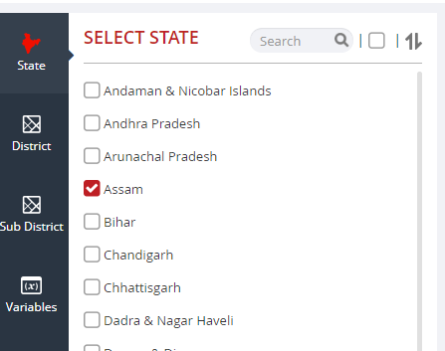
A Sample Case Study
Select the top 5 districts with highest rural MPI
Step 1: Select State ‘Assam’
Step 2: Select District (Select all using check box placed beside search tool)

Slide 14
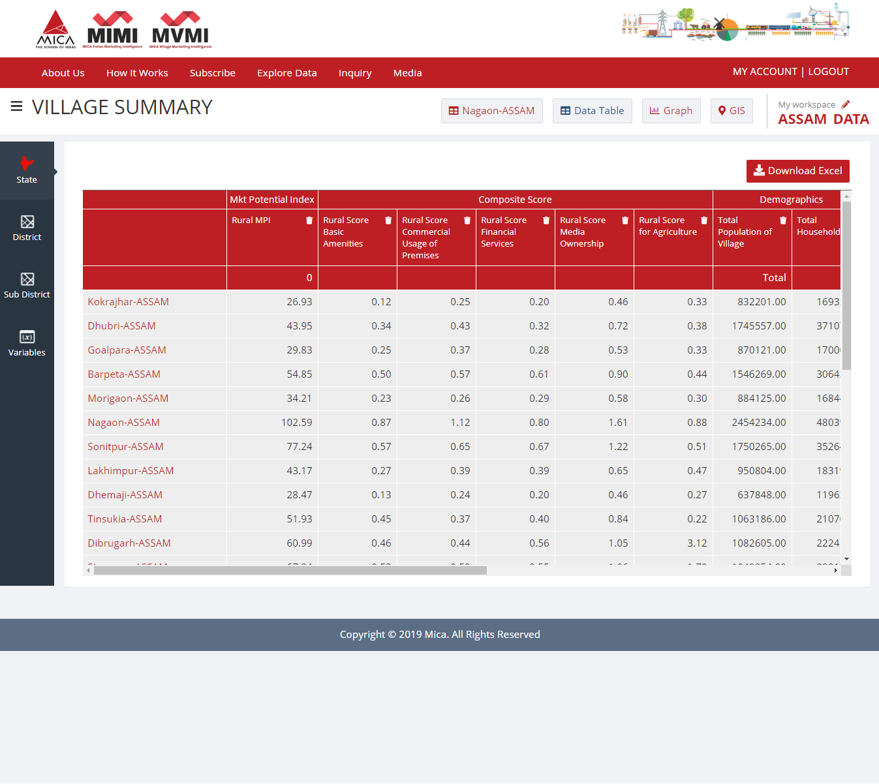
Check Your Explored Database in Data Table
Click here to Export your Selected Database

Slide 15
Downloaded data in ‘.xls’ file format
Data of State-> District | Rural MPI
Nagaon-ASSAM | 102.59
Sonitpur-ASSAM | 77.24
Kamrup-ASSAM | 69.58
Sivasagar-ASSAM | 67.24
Dibrugarh-ASSAM | 60.99
Once data is downloaded in EXCEL file format then using ‘sort ‘ function districts can be arranged as per the highest MPI to the lower. Here, Nagaon is having Highest Rural MPI (102.59).

Slide 16
A Sample Case Study
Decide the variables relevant to the product/s company is planning to sell in the region. OR in general, variables relevant to the FMCG product. Consumption of FMCG products primarily depends on the following.
Population of the village
Awareness
Availability of the product in the village.
Awareness can be created through media and promotional campaign. Product can be made available through various market places.

Slide 17
A Sample Case Study
Thus relevant variables for rural marketing of FMCG product can be listed as;
Consumption Indicators
Rural MPI
No of Villages
No of HH
Total population in Villages
Marketing Places
Mandis/Regular Market,
Weekly Haat
Places Can be used for Promotion
No of Schools and Colleges
No of Villages Having Community Centre
No of Villages Having Cinema/Video Hall
Availability of Media
No of Villages Having Mobile Phone Coverage
No of Villages Having Daily Newspaper Supply

Slide 18
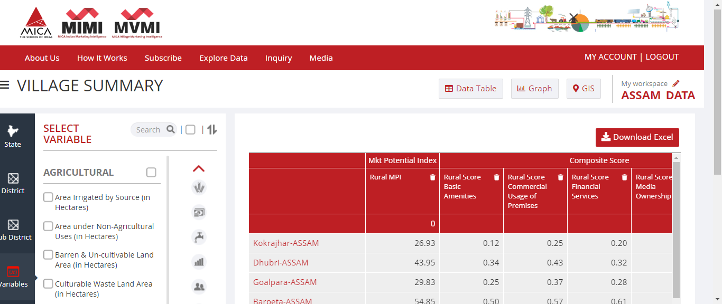
Check Your Explored Database in Data Table
Click here to Export your Selected Database
Please Click here on the group icons to view your Selected Variables

Slide 19
A Sample Case Study
District | Rural MPI | No of Villages | No of HH | Total population in Villages | Mandis/Regular Market | Weekly Haat | No of Schools and Colleges | No of Villages Having Community Centre | No of Villages Having Cinema/Video Hall | No of Villages Having Daily Newspaper Supply | No of Villages Having Mobile Phone Coverage
Nagaon | 102.5949 | 1412 | 480399 | 2454234 | 396 | 961 | 5410 | 199 | 27 | 588 | 1078
Sonitpur | 77.2419 | 1876 | 352647 | 1750265 | 300 | 1171 | 3862 | 93 | 27 | 674 | 1308
Kamrup | 69.5752 | 1068 | 280269 | 1375148 | 347 | 630 | 5175 | 197 | 3 | 743 | 767
Sivasagar | 67.2417 | 875 | 222136 | 1040954 | 89 | 426 | 3203 | 67 | 6 | 655 | 751
Dibrugarh | 60.991 | 1348 | 222414 | 1082605 | 136 | 630 | 3086 | 67 | 9 | 616 | 1020
It can be concluded from the data that; Nagaon has maximum no of households and maximum population. Maximum no of regular markets, though weekly haats are marginally less compared to Sonitpur. Thus, selling the product in the villages of Nagaon is much easier compared to other districts. Considering promotion of the product, again Nagoan is the district with a maximum no of schools/colleges and community centers. Considering advertising the products, Sonitpur is the best as it has maximum no of villages with mobile coverage and having daily newspaper.

Slide 20
You can easily represent your selected data graphically by using two different type of Charts
Please Select /Change type of Chart
Click on ‘Filters’ to Select Variables & districts for Chart
Please Click here to Export Chart for selected Data in ‘PDF‘

Slide 21
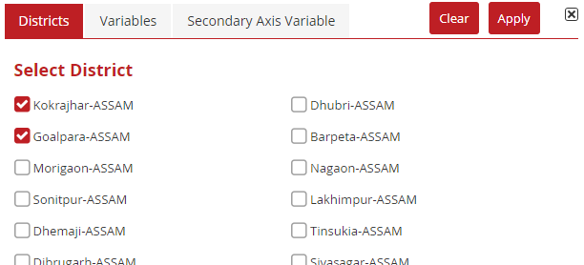
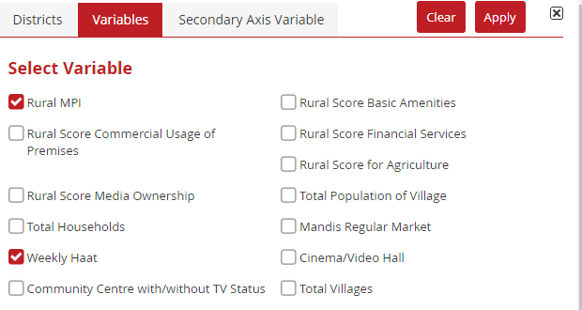
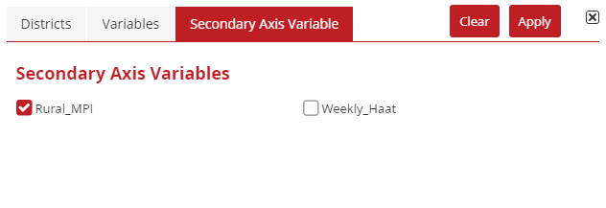
Dialogue-Box : Filters
Click on ‘Filters’ to select Districts and a Variable
Click on ‘Apply Changes’ to Generate Bar Chart

Slide 22
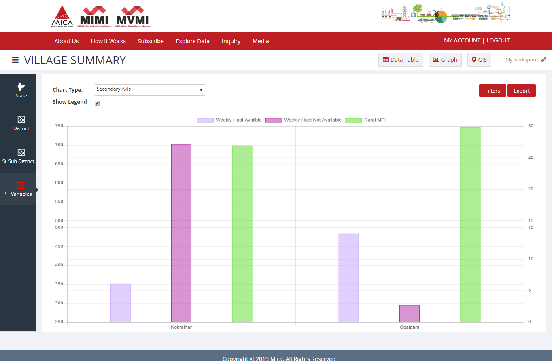
Second Level Chart (Bar)
Range of MPI is 1.00 to 1000.00
Population figures above 100000
Click on ‘Filters’ to Select Variables & districts for Chart

Slide 23
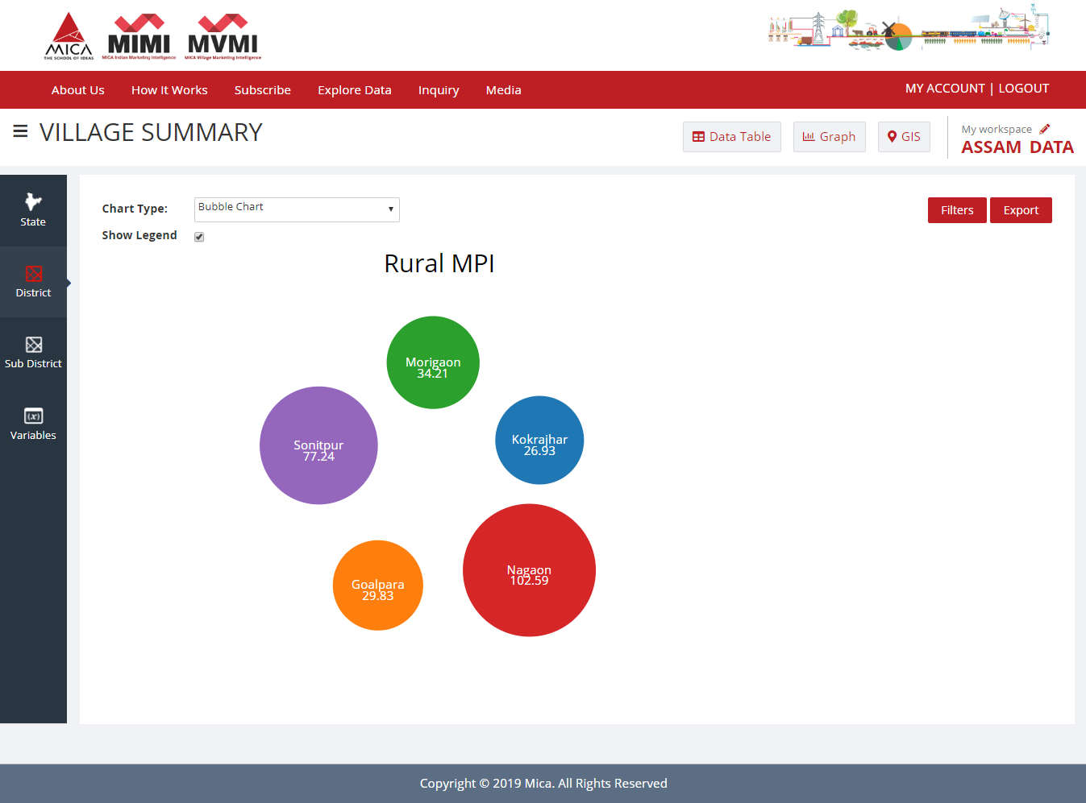
Bubble Chart
Click on ‘Filters’ to Select Variables & districts for Chart

Slide 24
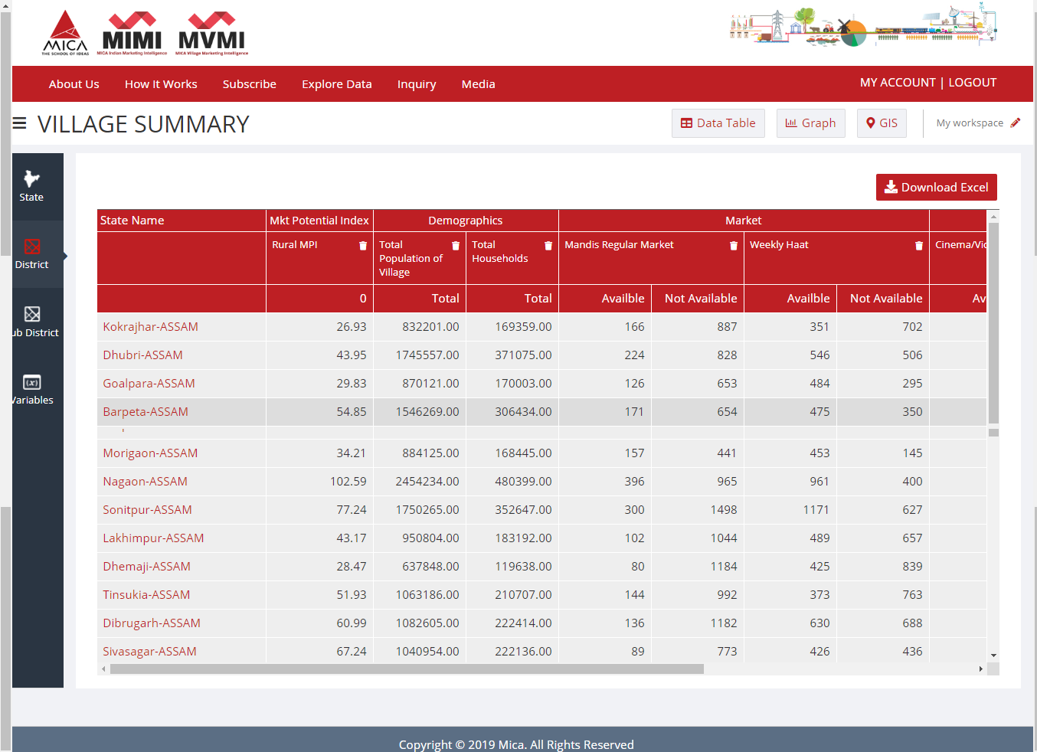
Data Table as per Villages
Considering the relevant variable, Nagaon can be selected . Click on Nagon to view village wise data of it
Click on Nagaon

Slide 25
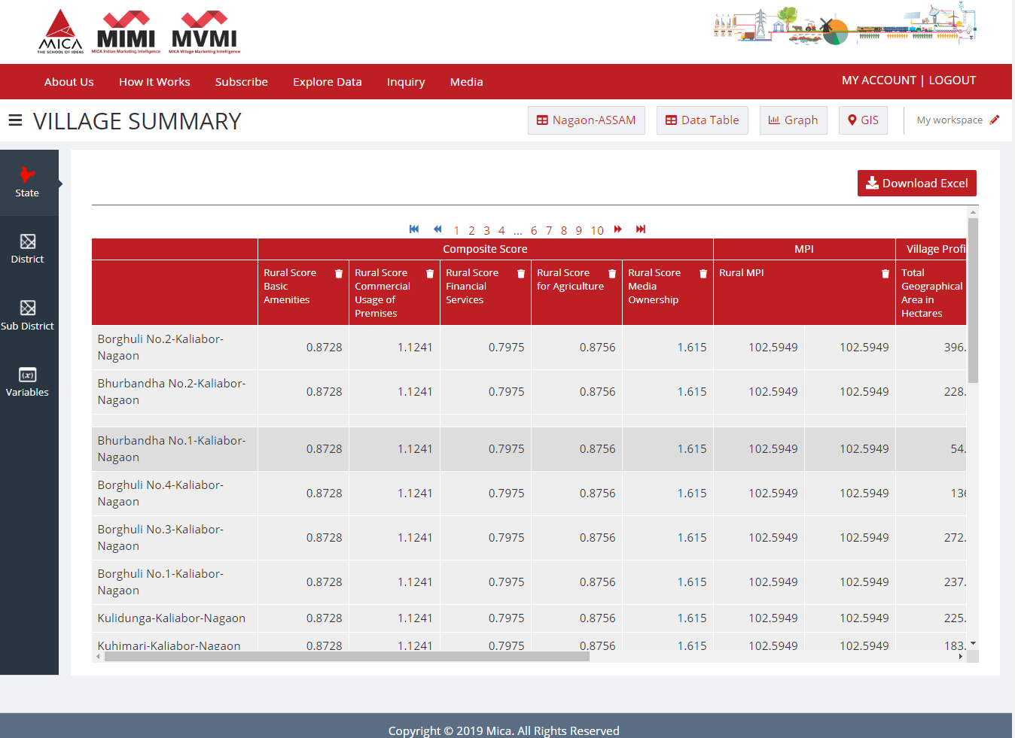
Data Table as per Villages
Click here to load village summary at District level

Slide 26
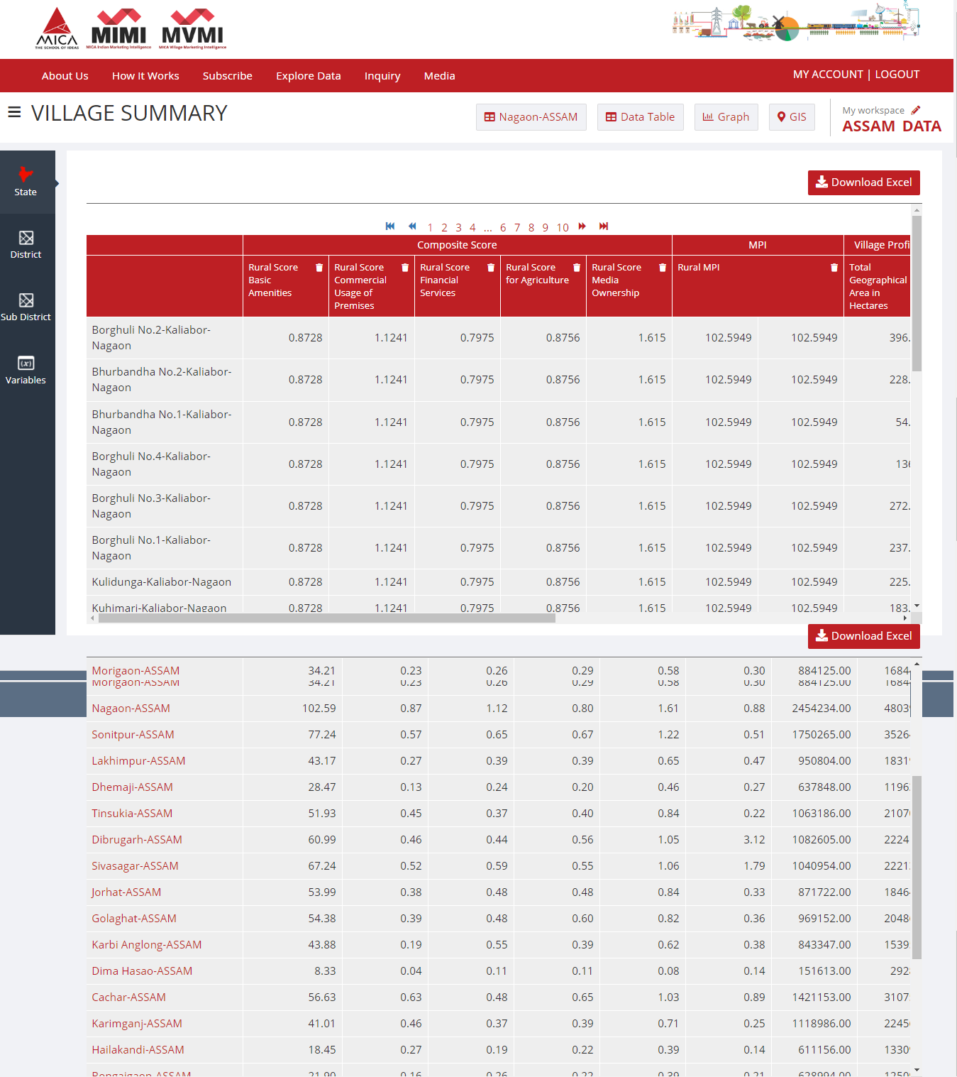
Record your selections: My Workspace

Slide 27
Downloaded data in ‘.xls’ file format
(Village wise data of Nagaon with relevant variables)
Village Name | Total Geographical Area (in Hectares) | Total Households | Total Population of Village | Govt & Pvt Pre/ Primary Schools | Govt/Pvt Middle & Secondary School (Numbers) | Nearest Town Name
Borghuli No.2 | 396.29 | 1045 | 6122 | 5 | 3 | TEZPUR
Jakhalabandha Town | 129.3 | 1012 | 4625 | 5 | 4 | TEZPUR
Sonaribali | 419.87 | 1362 | 7050 | 3 | 2 | NAGAON
NizChalchali | 297.84 | 1081 | 4685 | 8 | 4 | NAGAON
Lailuri | 527.15 | 1507 | 7472 | 9 | 3 | NAGAON
Pachim Singimari | 274.44 | 1105 | 5428 | 4 | 3 | NAGAON
Gayan Gaon | 395.57 | 1048 | 5472 | 7 | 4 | DHING
Bechamari | 332.65 | 1081 | 5405 | 9 | 5 | DHING
Dhania Bheti Gaon | 347.99 | 1488 | 7201 | 8 | 4 | DHING
Jamuguri | 339.74 | 1177 | 5557 | 14 | 4 | NAGAON
Rowmari | 323.96 | 1140 | 6250 | 6 | 0 | NAGAON
Lao Gaon | 240.78 | 1249 | 6955 | 5 | 2 | NAGAON
Silangani Gaon | 260.6 | 1101 | 5781 | 4 | 3 | NAGAON
Ranga Gara Huzz | 158.91 | 1046 | 4985 | 6 | 3 | NAGAON
Niz Barapujia | 205.26 | 1245 | 5918 | 8 | 4 | RAHA
Bakula Guri | 659.33 | 1215 | 6218 | 10 | 8 | KAMPUR
Dakshin Debasthan | 254.88 | 1011 | 5856 | 3 | 1 | HOWRAGHAT
Dakhin Laskar Pathar | 682.74 | 1063 | 6053 | 5 | 3 | HOWRAGHAT

Slide 28
A Sample Case Study
Summary of Data Extracted from MVMI reveals that;
Total no of households in the 18 villages: 20,976
Total population of 18 villages: 1,07,0333
Total no of primary schools: 119 and secondary schools: 60
All these villages have supply of daily newspapers and except three villages namely; Jamuguri, Silangani Gaon and Dakshin Debasthan have mobile coverage.
All these 18 villages have weekly haat Except two villages Niz Chalchali and Ranga Gara Huzz all the others have Mandis/ Regular market.
Thus, the 18 villages of Nagaon district could be deemed the most appropriate for market entry in Assam’s rural market.

Slide 29
Thanks a lot….
Let’s build a solid marketing strategy for India with MIMI today
Contact us :-MICA, Ahmedabad
Shela, Ahmedabad - 380 058
Gujarat, India
Tel: +91 02717 – 308250.
E-mail: mimi@micamail.in
Web-address: www.mica-mimi.in

