Slide 1



Tutorial for MICA Indian Marketing Intelligence (MIMI)
A Product from MICA
www.mica-mimi.in

Slide 2
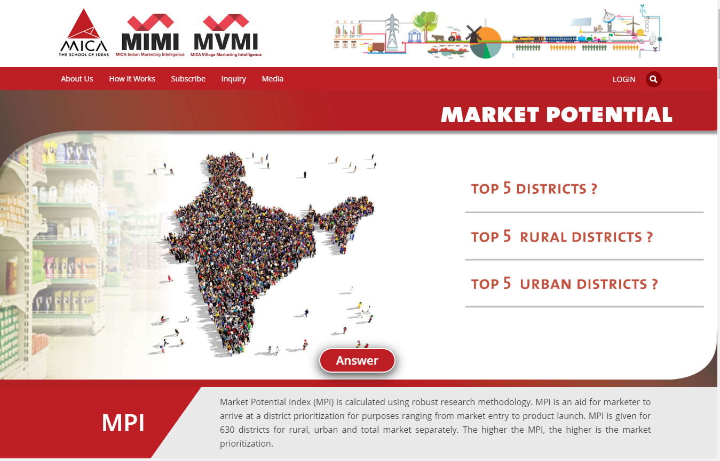
Home Page

Slide 3
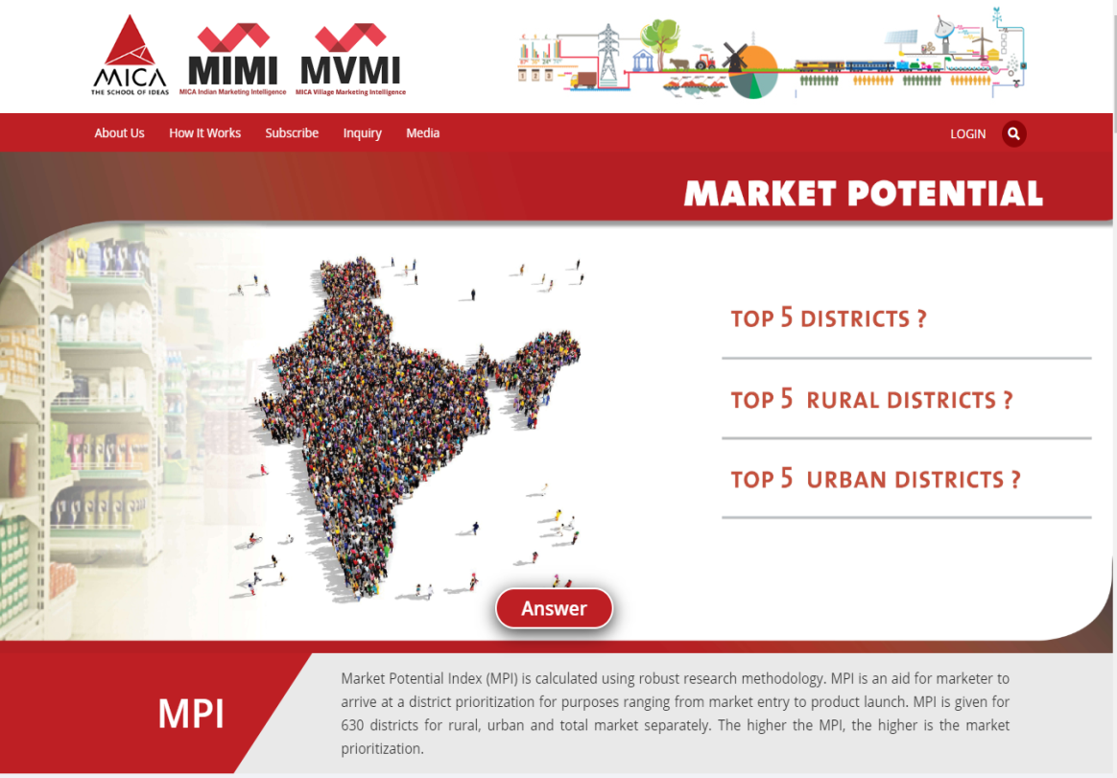
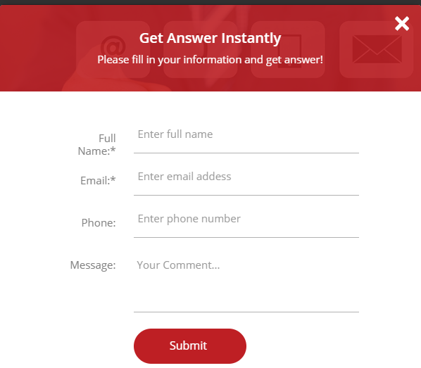
Home Page
Are you Curious to know this??
Please Click here and Share your contact details
Kindly Share your contact details and Click on 'Submit’

Slide 4
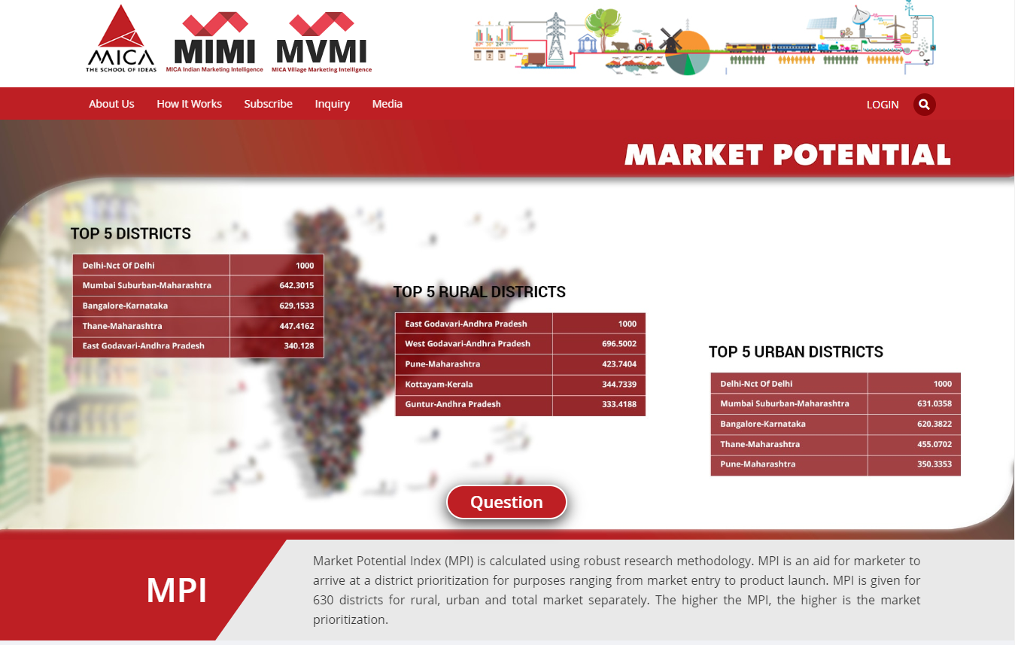
Here is the Answer

Slide 5
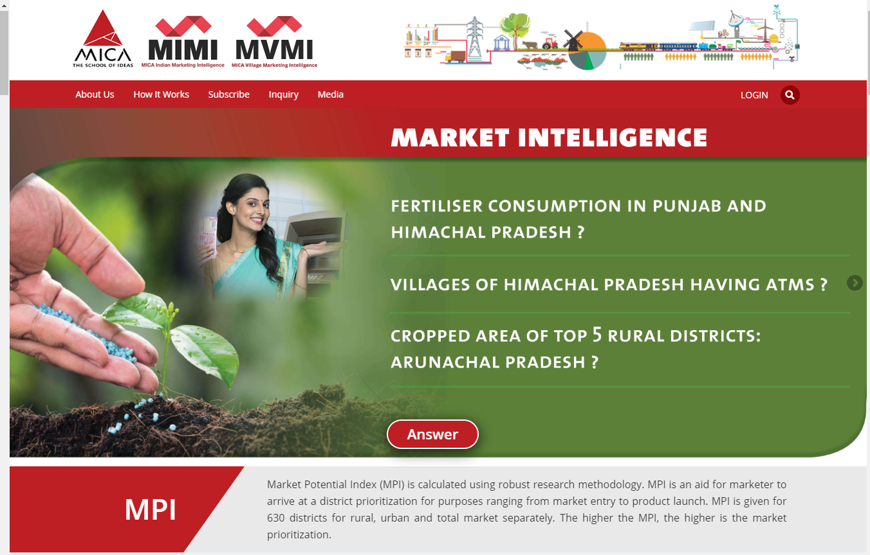
Home Page
Are you Curious to know this??

Slide 6
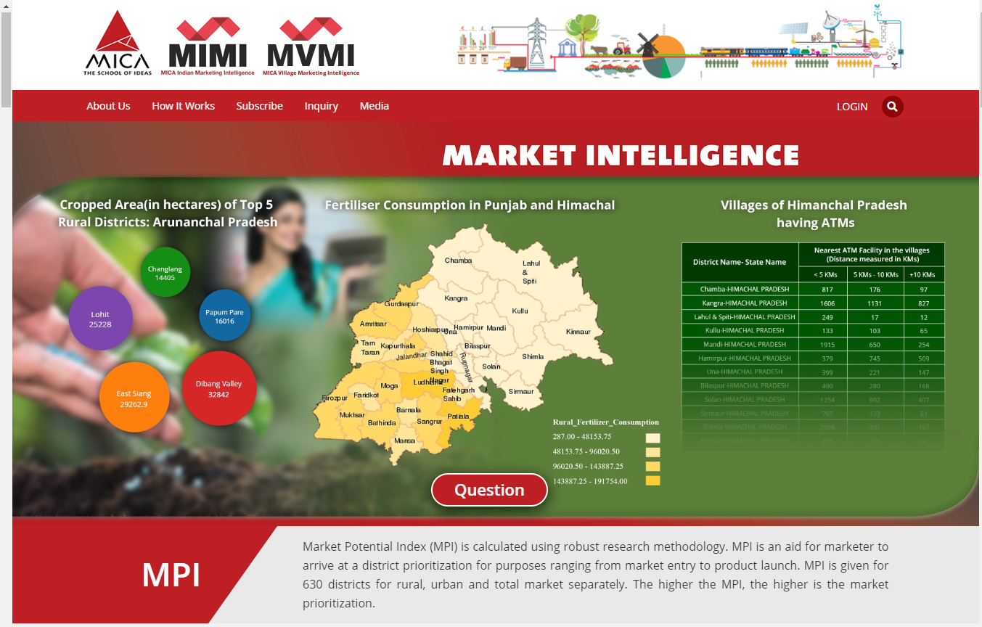
Here is the Answer

Slide 7
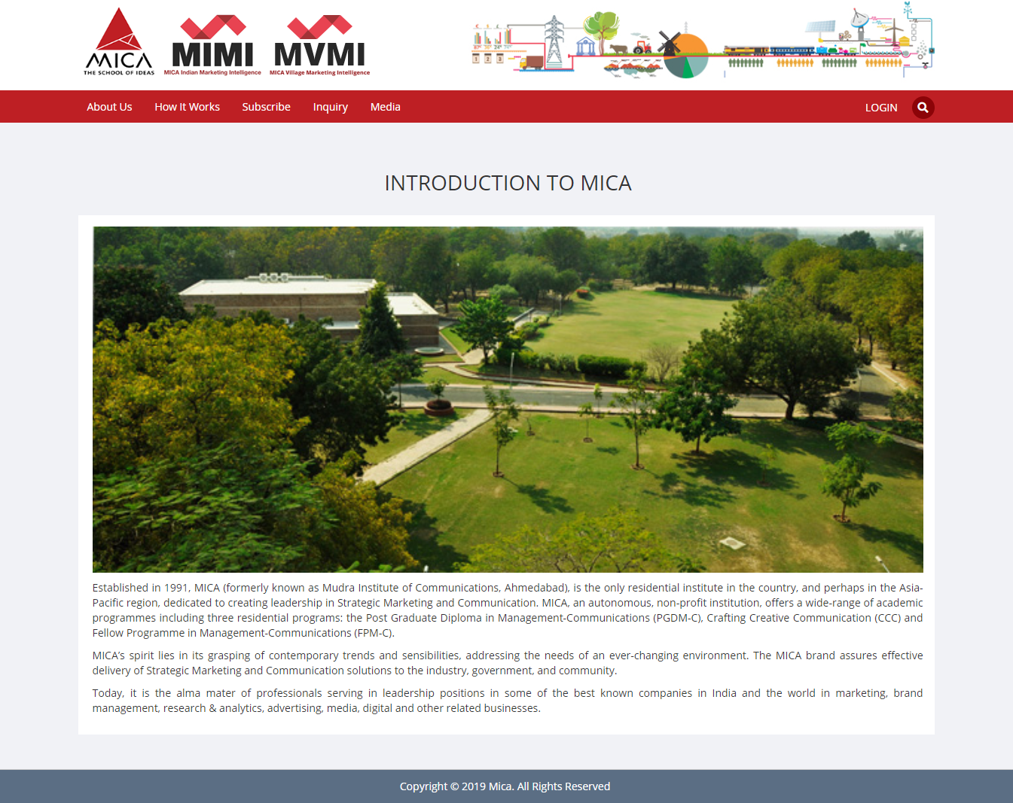
Introduction to MICA

Slide 8
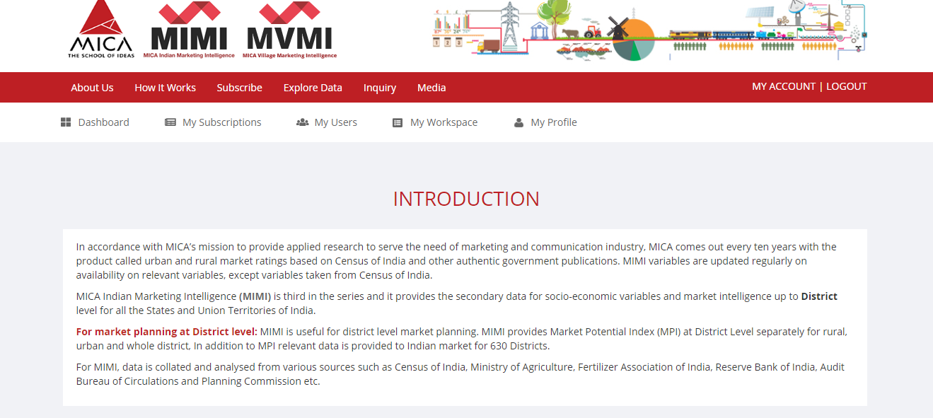
Introduction to Market Intelligence

Slide 9

Introduction to Market Intelligence
Scroll down to know More..
UNIQUE FEATURE
SECTORS WE COVER
DATA SOURCES
METHODOLOGY
MIMI TEAM
DOWNLOAD BROCHURE

Slide 10
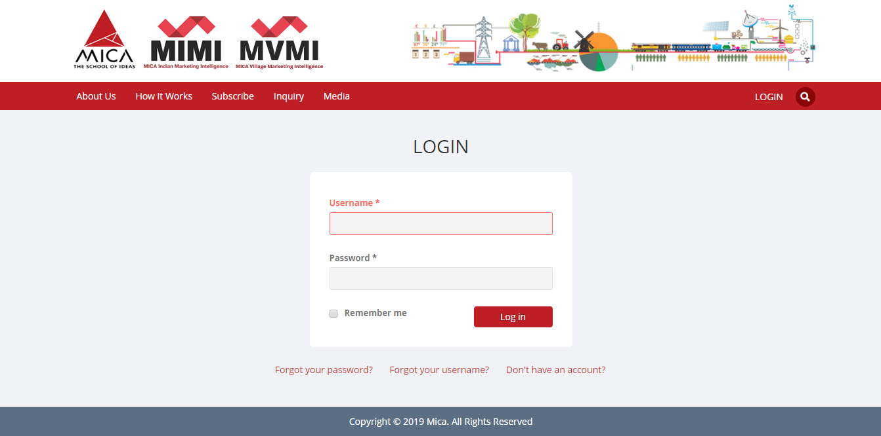
Log-in Page
Please Enter Your Login Credentials

Slide 11
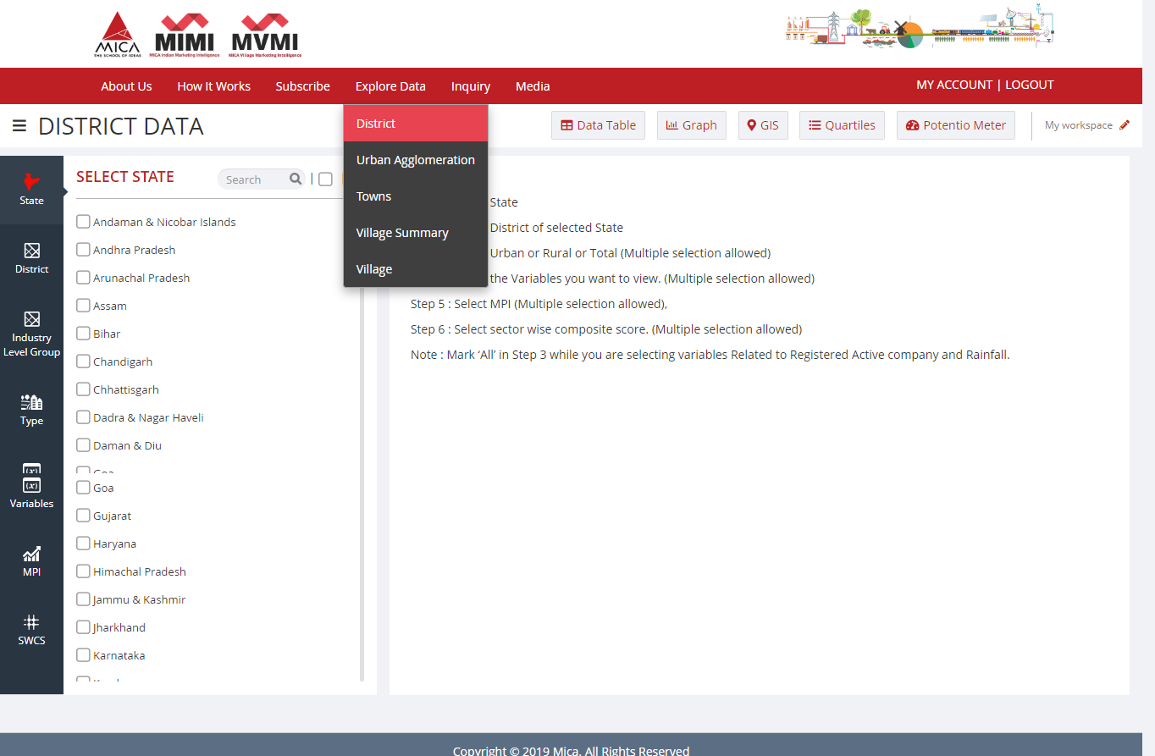
Explore Data (District level/Urban Agglomeration/ Towns)
Explore Data → District

Slide 12
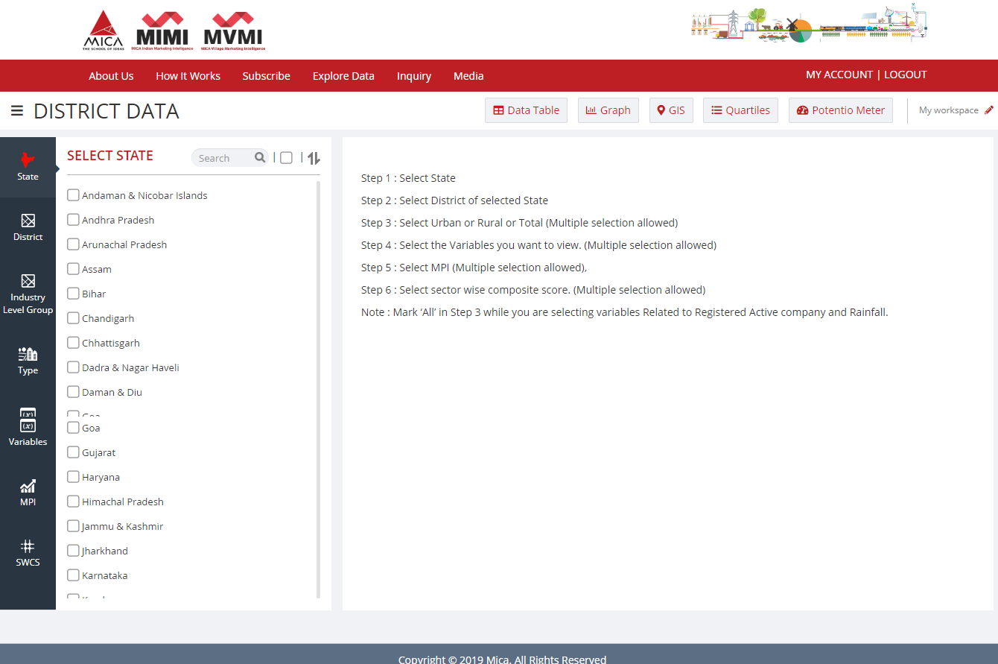
Explore the Database as per your requirement.

Slide 13
A Sample Case Study: Branch Expansion in Rural Bihar
A leading Bank would like to expand its rural branch network in the state of Bihar.
How can they prioritise required number of districts with the help of MIMI?
For this, You may please select following variables from “Explore Data” Screen :
1) Rural MPI
2) Rural Population
3) Rural Value of Crop Production
4) Rural Value of Crop Production Agriculture
5) Rural Value of Crop Production Horticulture
6) Rural Amount Deposit
7)Rural Shop or Offices

Slide 14
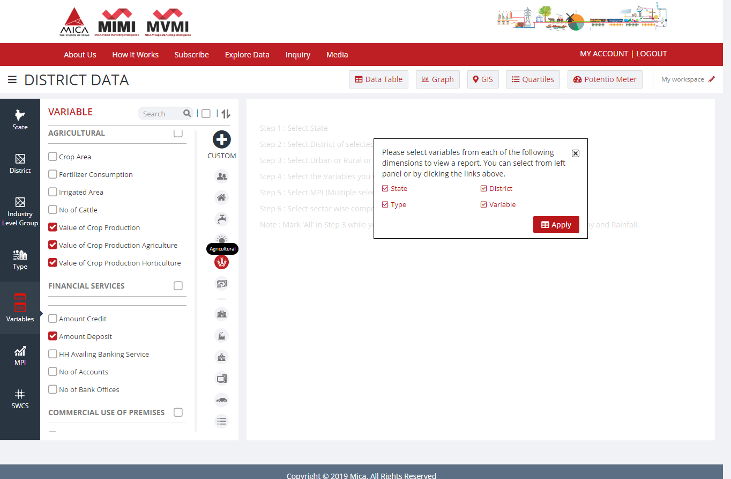
Exploring the database for Case Study
Click Here ‘Apply Changes’

Slide 15
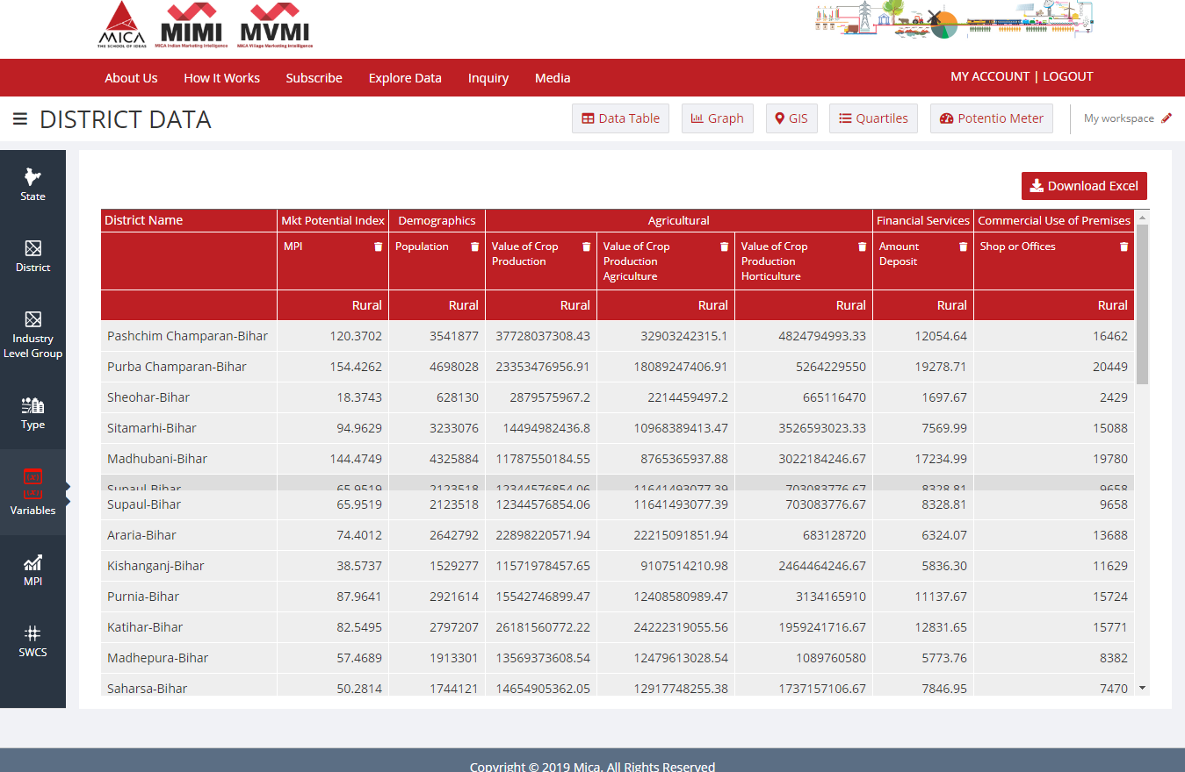
Check Your Explored Database in Data Table
Click here to Export your Selected Database
Please Click here to view your Selected Variables

Slide 16
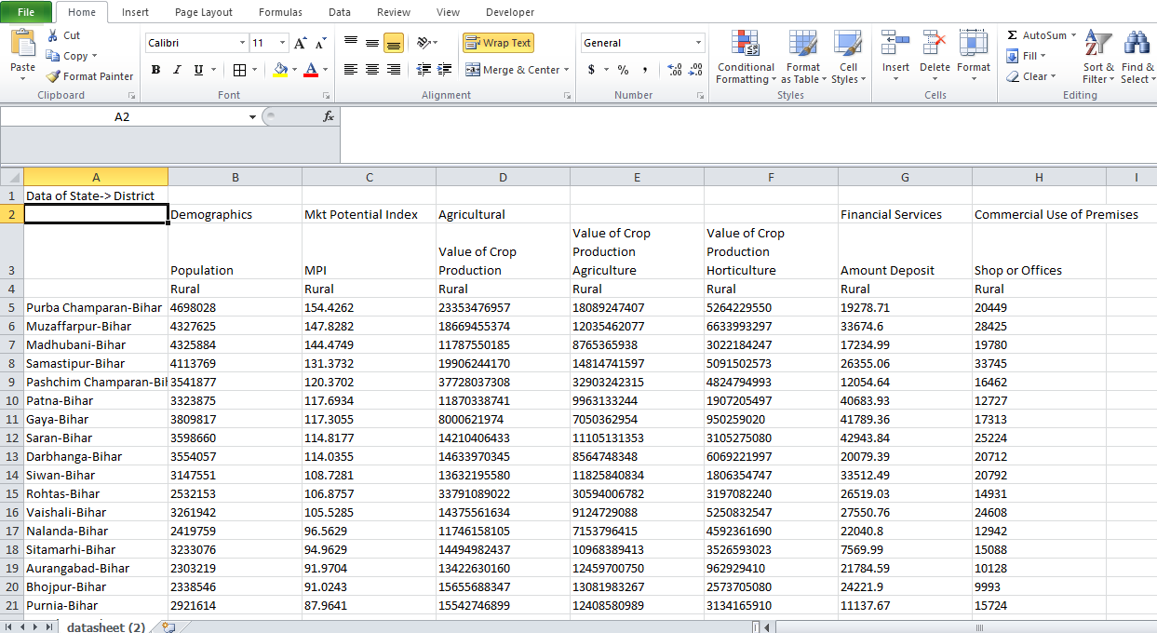
Downloaded data in ‘.xls’ file format

Slide 17
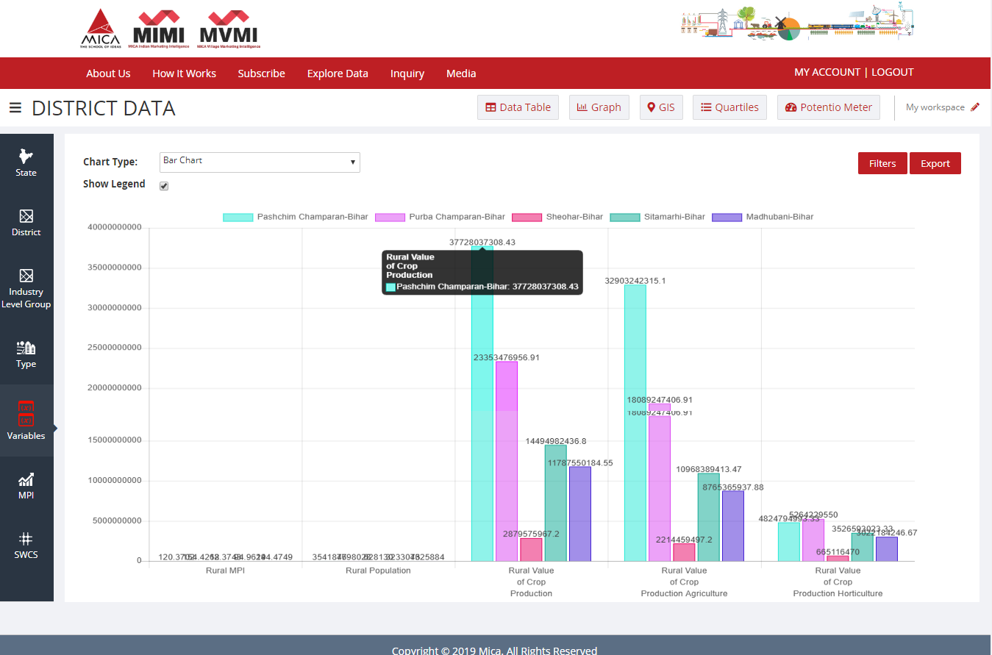
You can easily represent your selected data graphically by using four different type of Charts
Please Select /Change type of Chart
Click on ‘Filters’ to Select Variables & districts for Chart
Please Click here to Export Chart for selected Data in ‘PDF‘

Slide 18
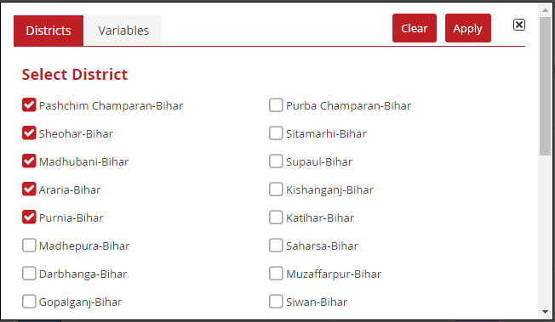
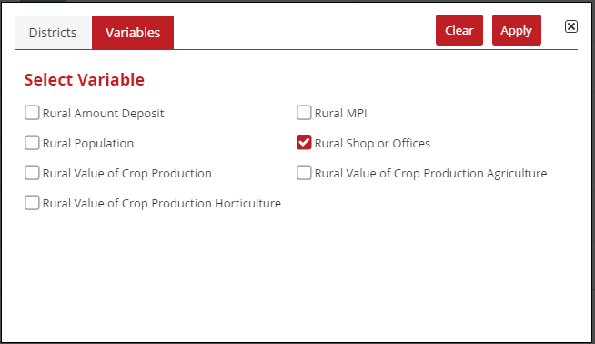
Dialogue-Box : Filters
Click on ‘Filters’ to select Districts and a Variable
Click on ‘Apply’ to Generate Bar Chart

Slide 19
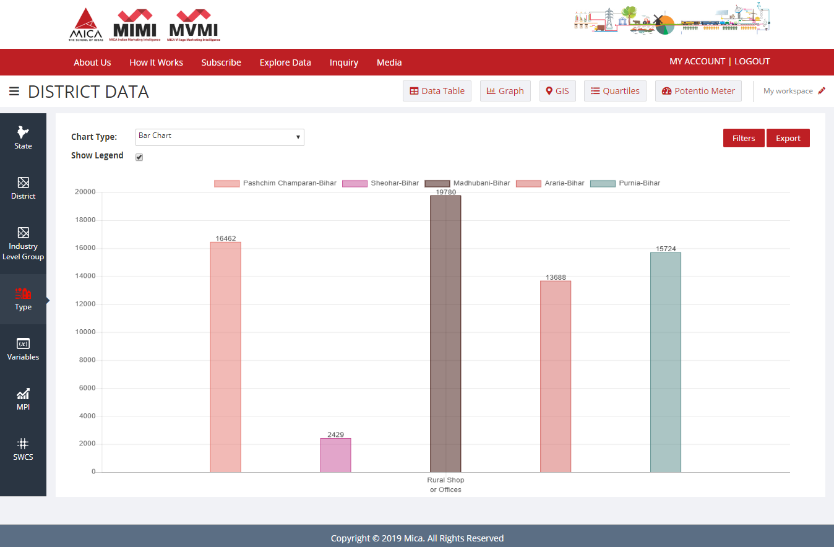
Second Level Chart (Bar)
Rural Shops or Offices
Please Select /Change type of Chart
Click on ‘Filters’ to Select Variables & districts for Chart
Please Click here to Export Chart for selected Data in ‘PDF‘

Slide 20
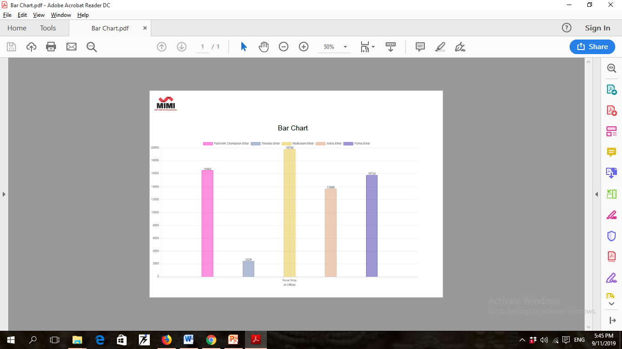
Downloaded Bar Chart in ‘PDF’ file format

Slide 21
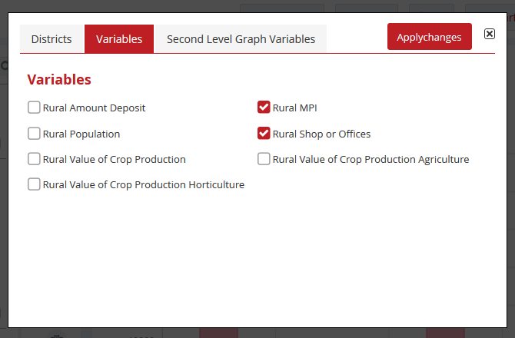
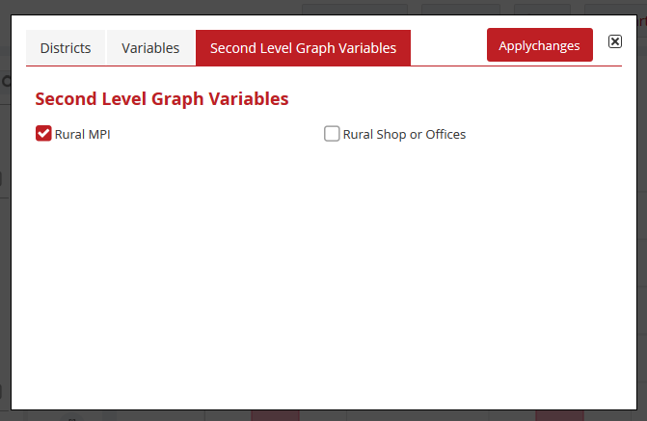
Selections in ‘Filters’ for ‘Second Level Chart’

Slide 22
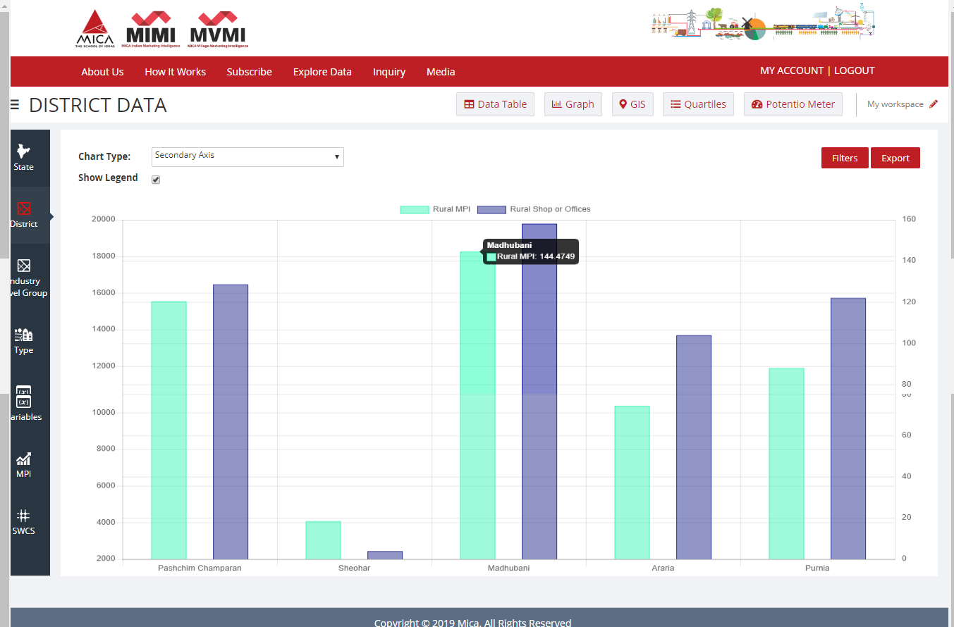
Second Level Chart (Bar)
Range of MPI is 1.00 to 1000.00
Range of Rural Shops or Offices is 200 to 2000
Click on ‘Filters’ to Select Variables & districts for Chart

Slide 23
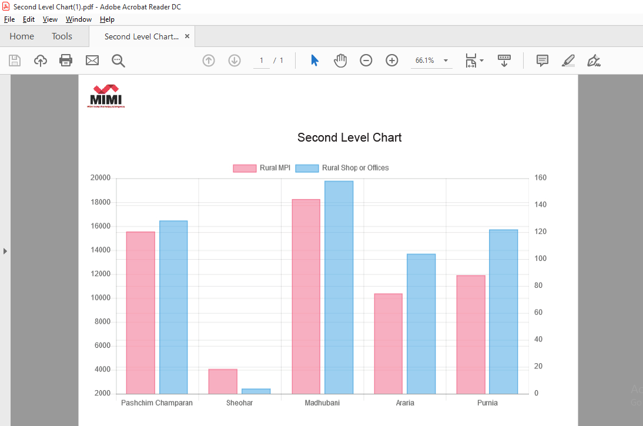
Downloaded Second Level Chart in ‘PDF’ file format

Slide 24
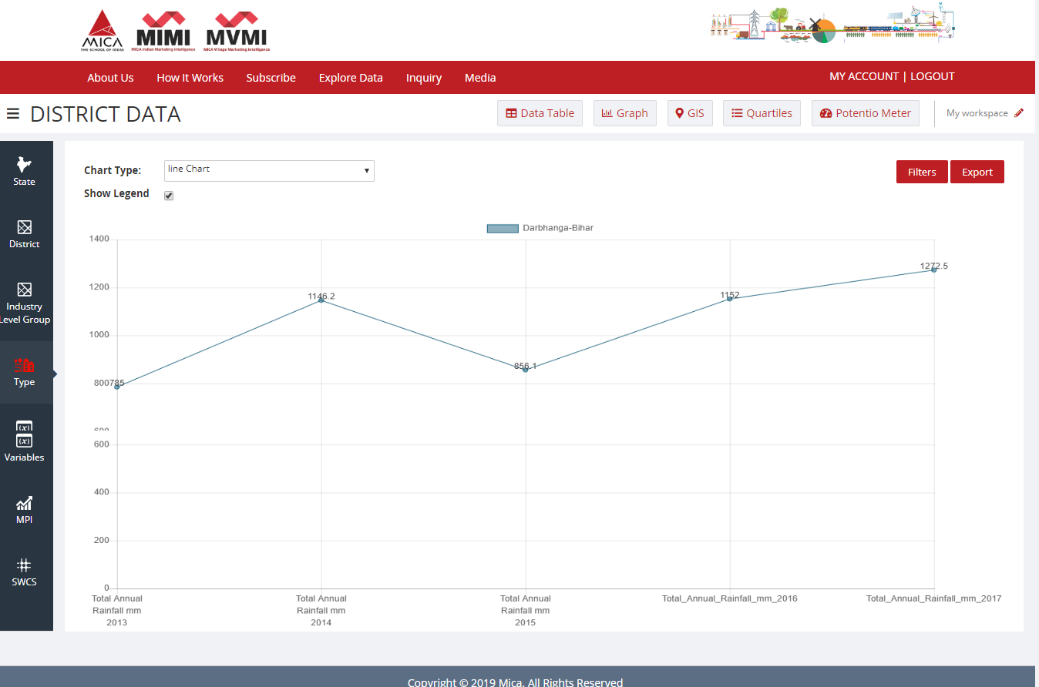
Line Chart
Click on ‘Filters’ to Select Variables & districts for Chart
Please Select /Change type of Chart
Please Click here to Export Chart for selected Data in ‘PDF‘

Slide 25
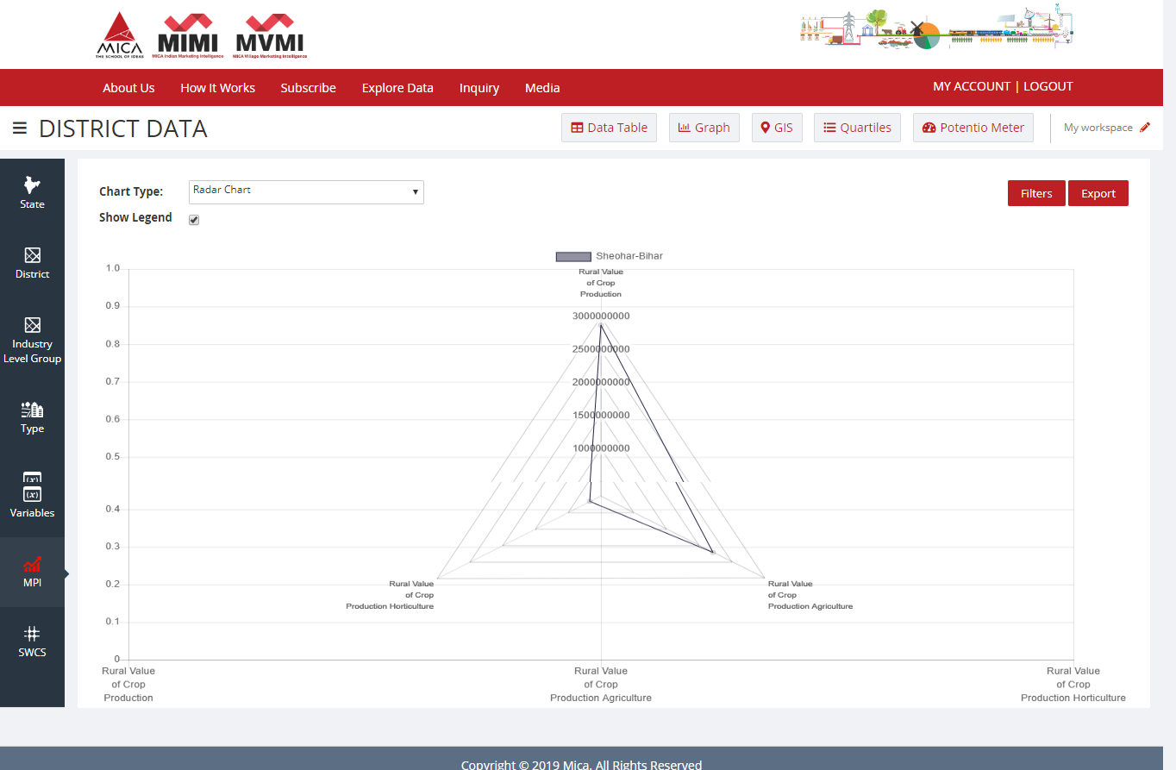
Radar Chart
Please Click here to Export Chart for selected Data in ‘PDF‘
Please Select /Change type of Chart

Slide 26
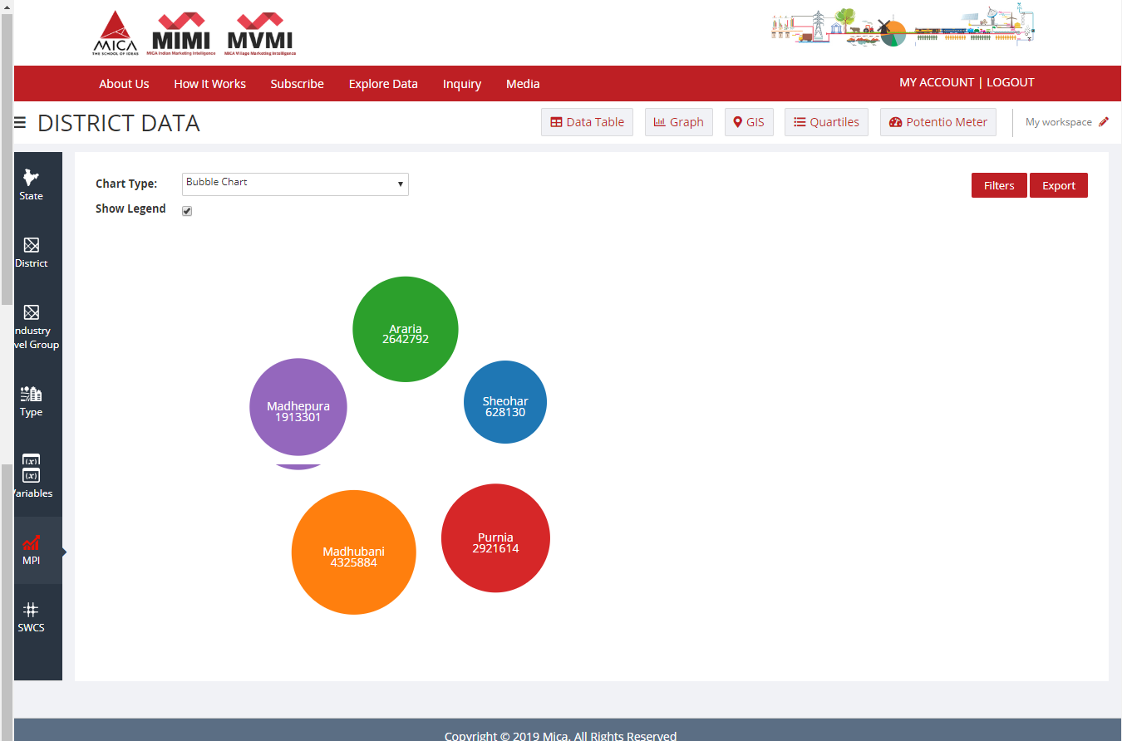
Bubble Chart
Click on ‘Filters’ to Select a Variable & some districts for a Chart

Slide 27
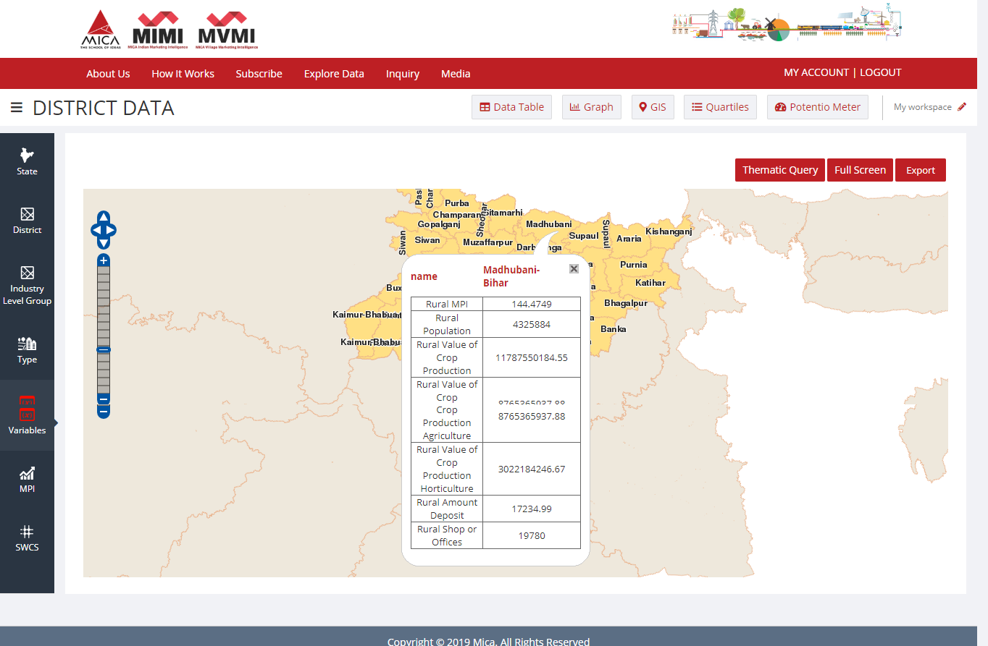
G.I.S.(Geographic Information System) Application
Click here to Export Map in ‘PDF’
Click here for full-screen display
Click here to modify your selections
Click here to view selected data for that particular a District

Slide 28
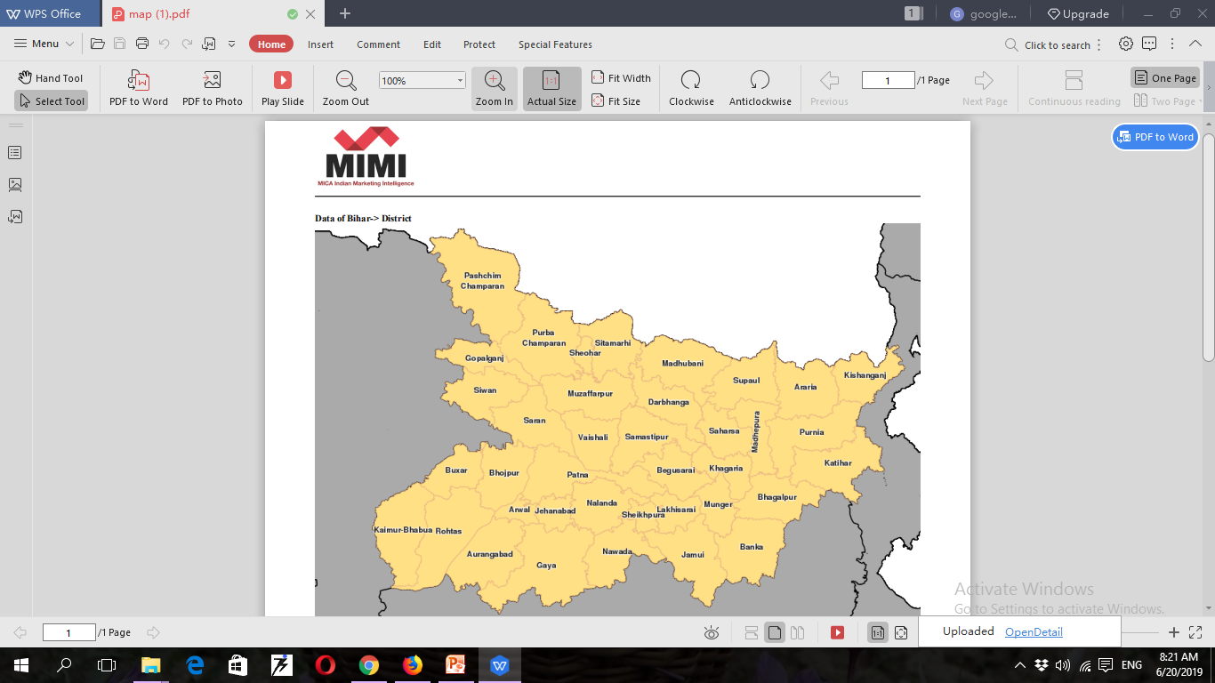
G.I.S. Application in PDF File Format

Slide 29
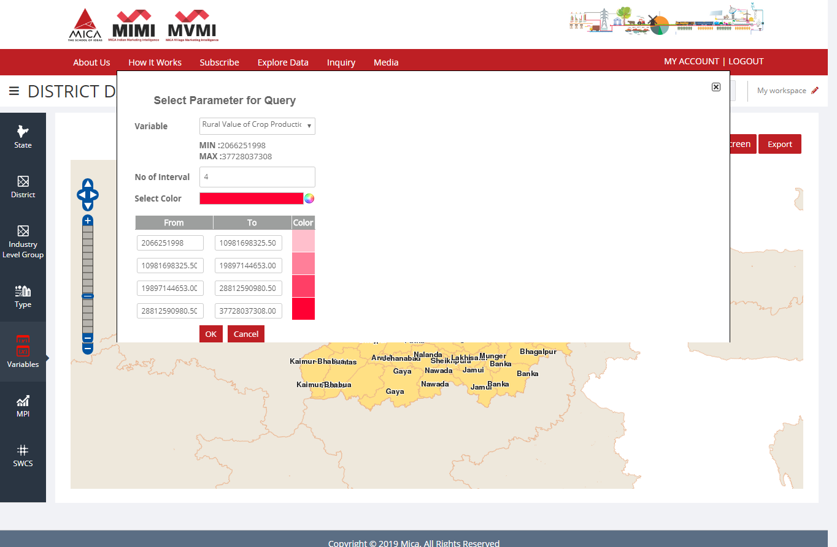
Thematic Query (With One Variable)
Select Your Preferred Variable
Up to ‘5 ‘ Groups

Slide 30
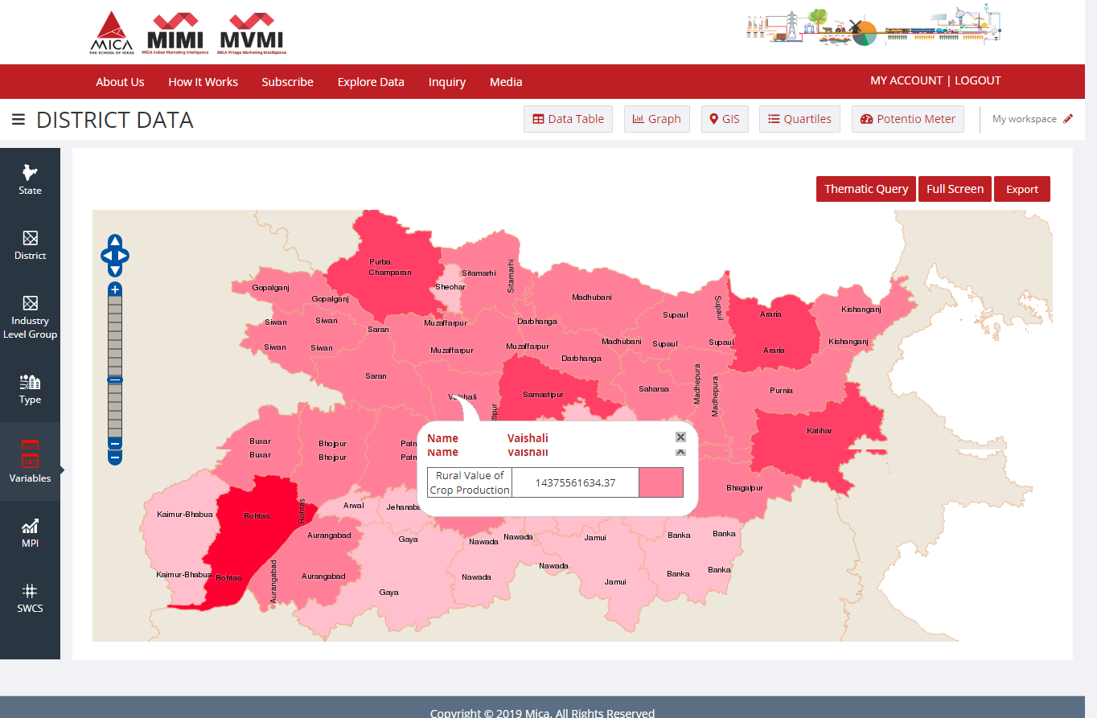
Out put of Thematic Query (With One Variable)
Click here to Export Map in PDF
Click here for full-screen display

Slide 31
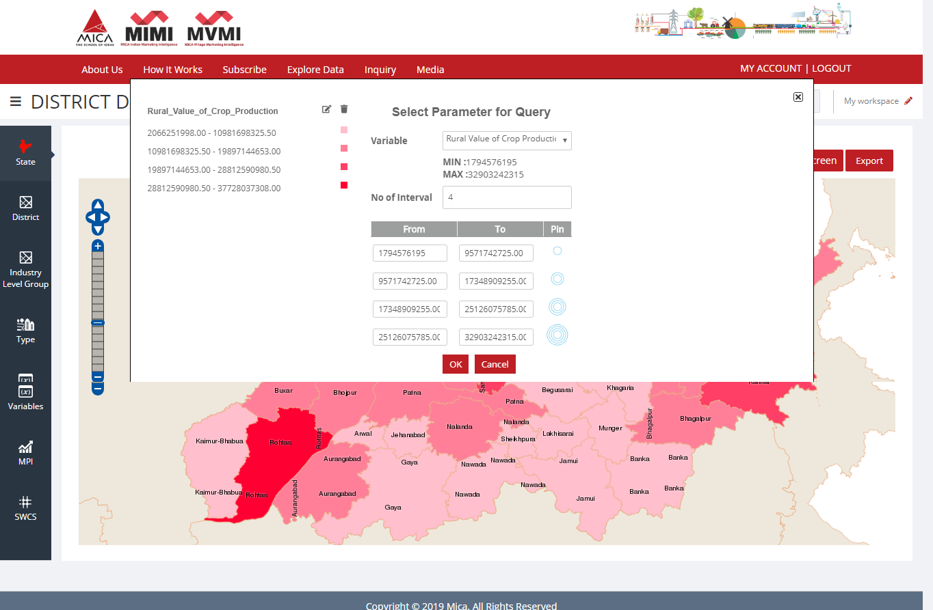
Thematic Query (With Two Variables)
Select Your Preferred Variable
Up to ‘5 ‘ Groups

Slide 32
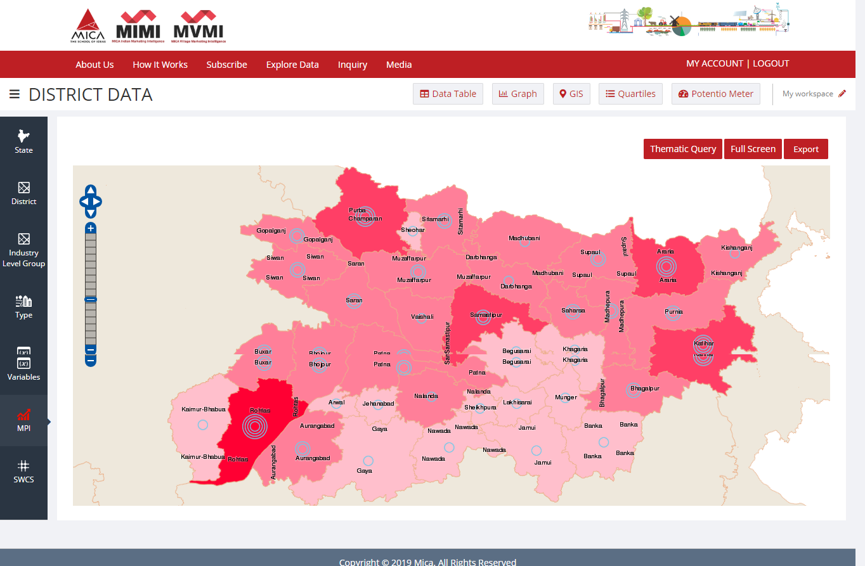
Out put of Thematic Query (With Two Variables)

Slide 33
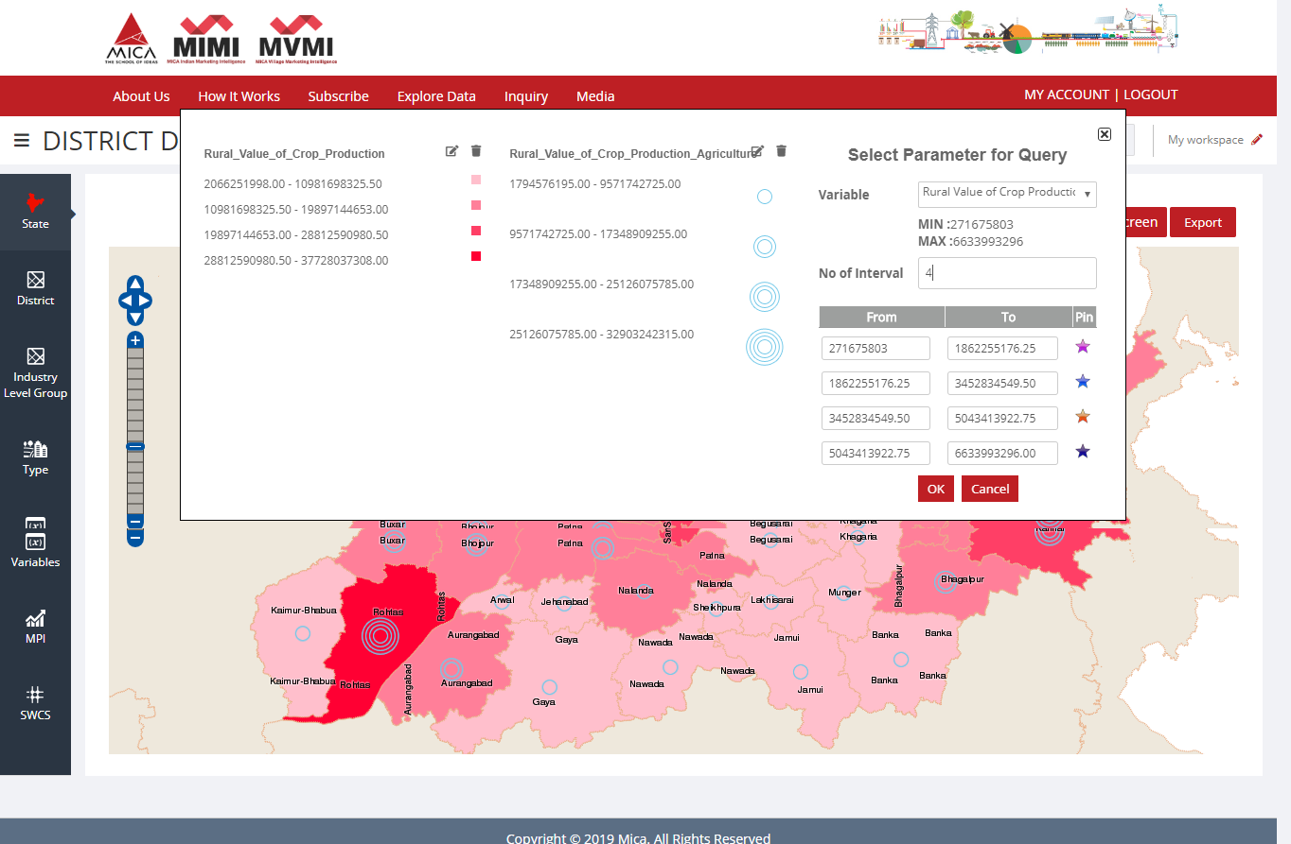
Thematic Query (With Three Variables)
Select Your Preferred Variable
Up to ‘5 ‘ Groups

Slide 34
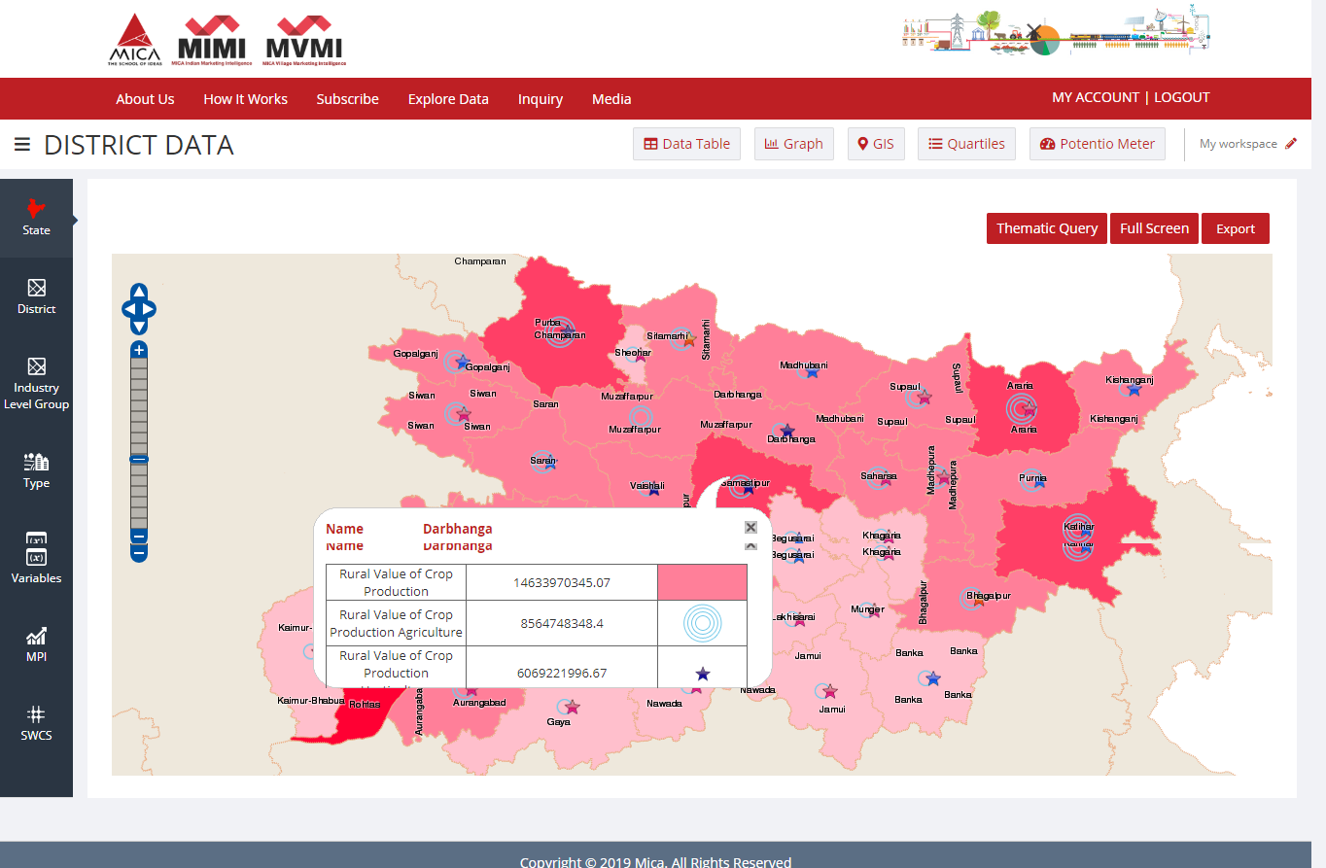
Out put of Thematic Query (With Three Variables)

Slide 35
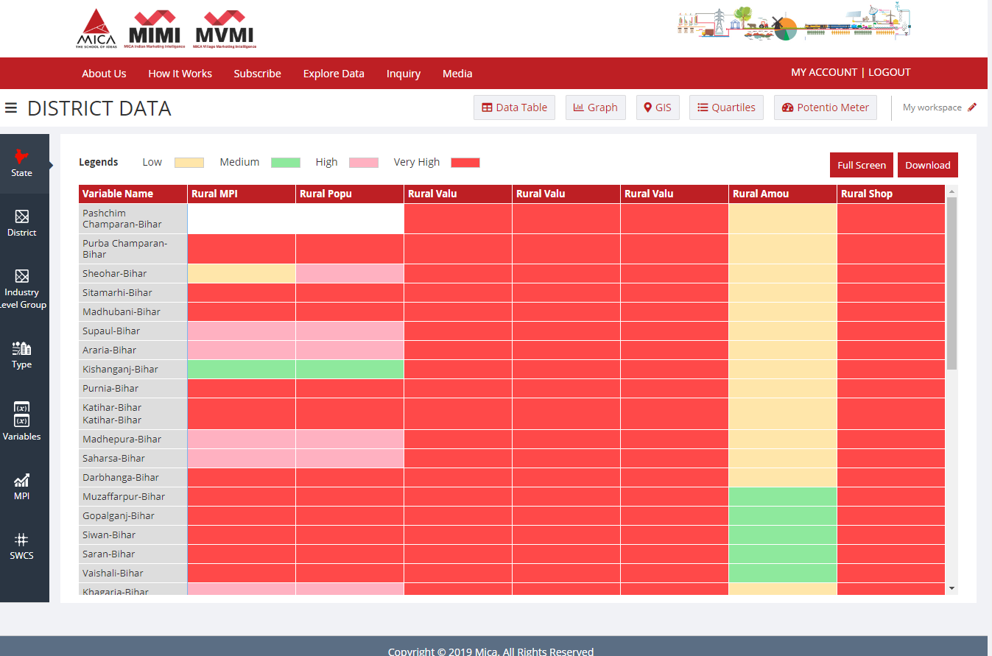
Quartiles (Color-Based Representation of Your Selected Database)
Click here to Export the ‘Quartile ‘ in ‘PDF’
Click here for full-screen display

Slide 36
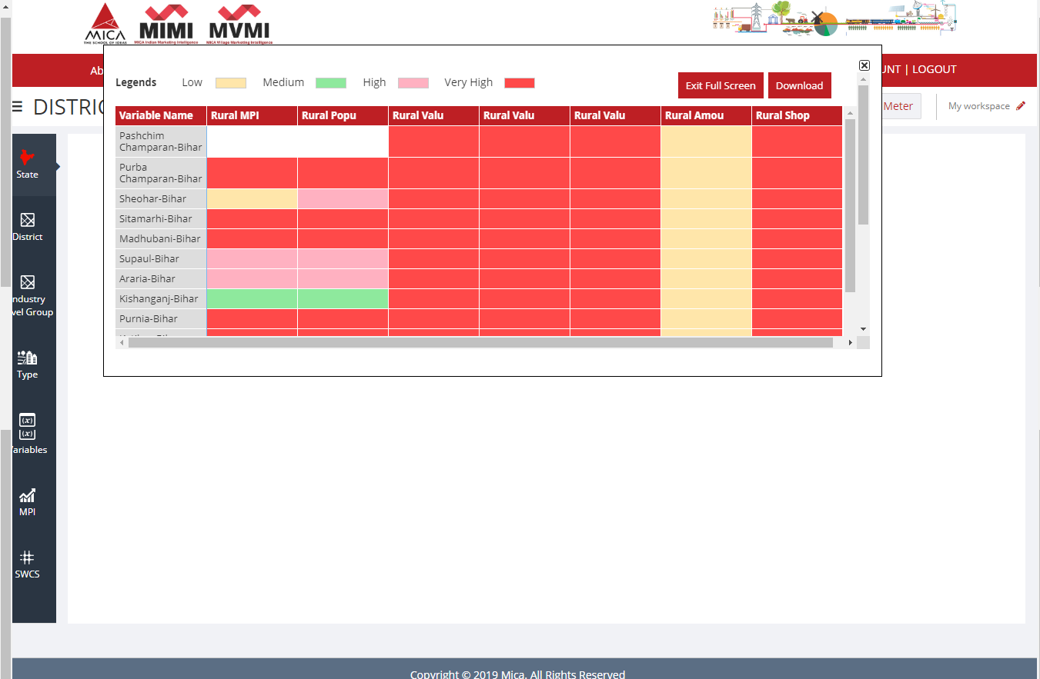
Full Screen Display of ‘Quartiles’
Click here to Export the ‘Quartile ‘ in ‘PDF’

Slide 37
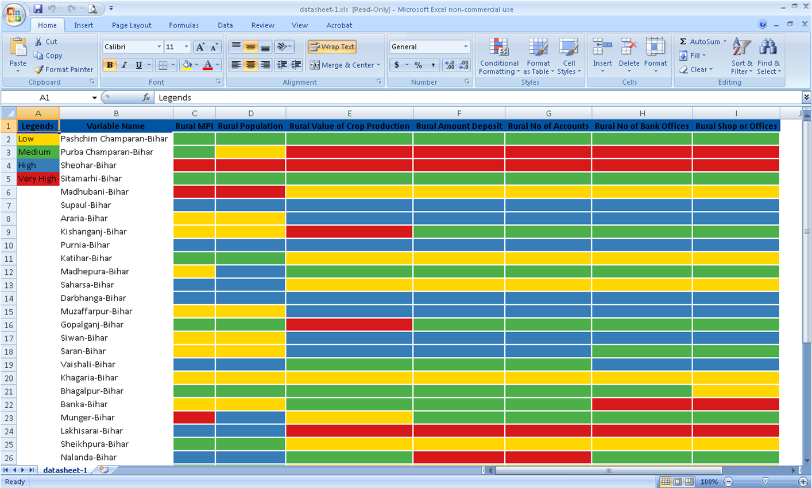
Exported ‘Quartiles’ in ‘.xls’ file format

Slide 38
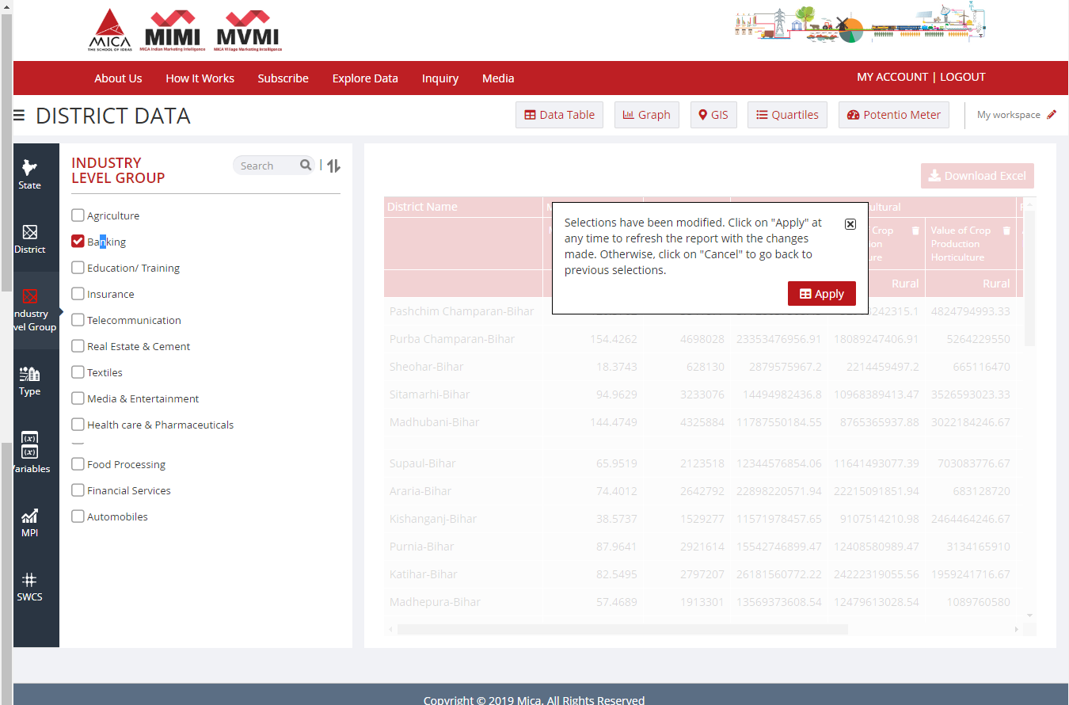
Select variables by Industry Level Group
Select Industry Group

Slide 39

Data Table as per Industry Level Group

Slide 40
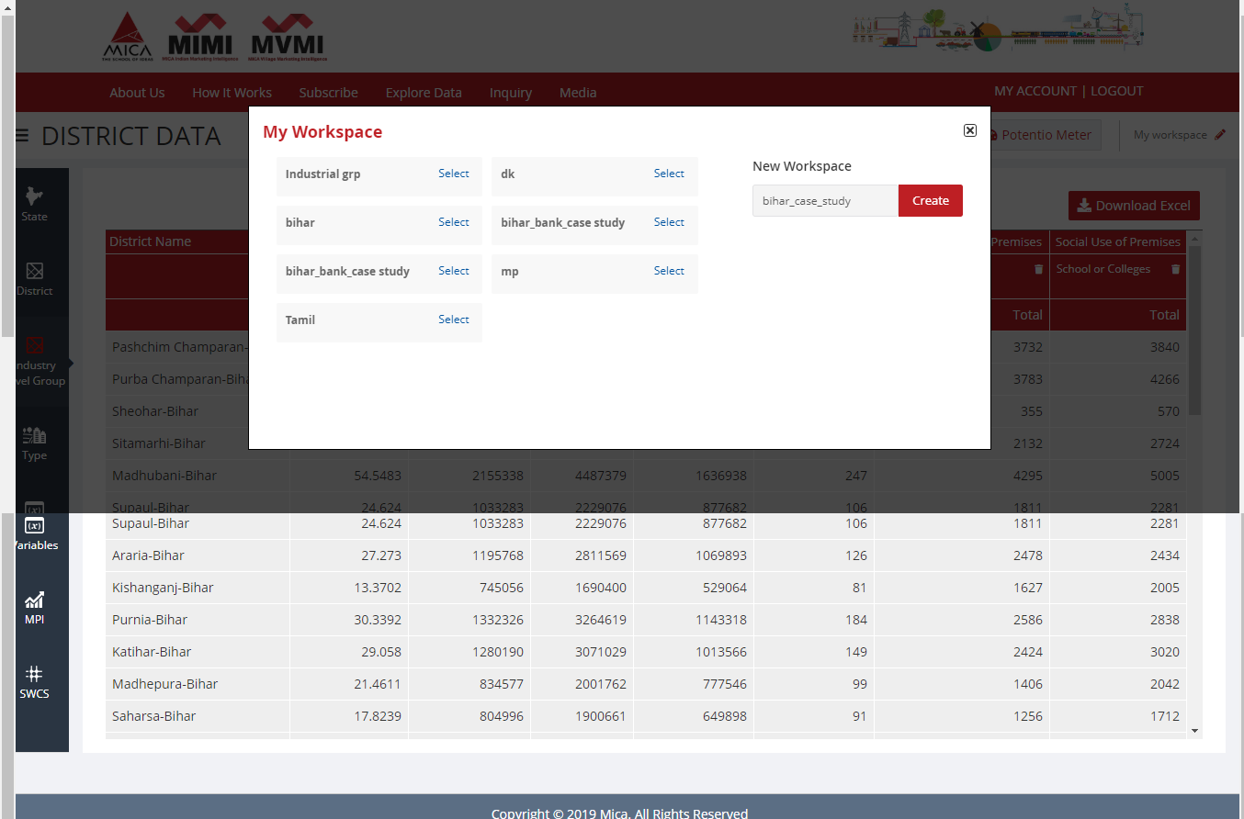
Record your selections: My Workspace
Mention workspace name

Slide 41
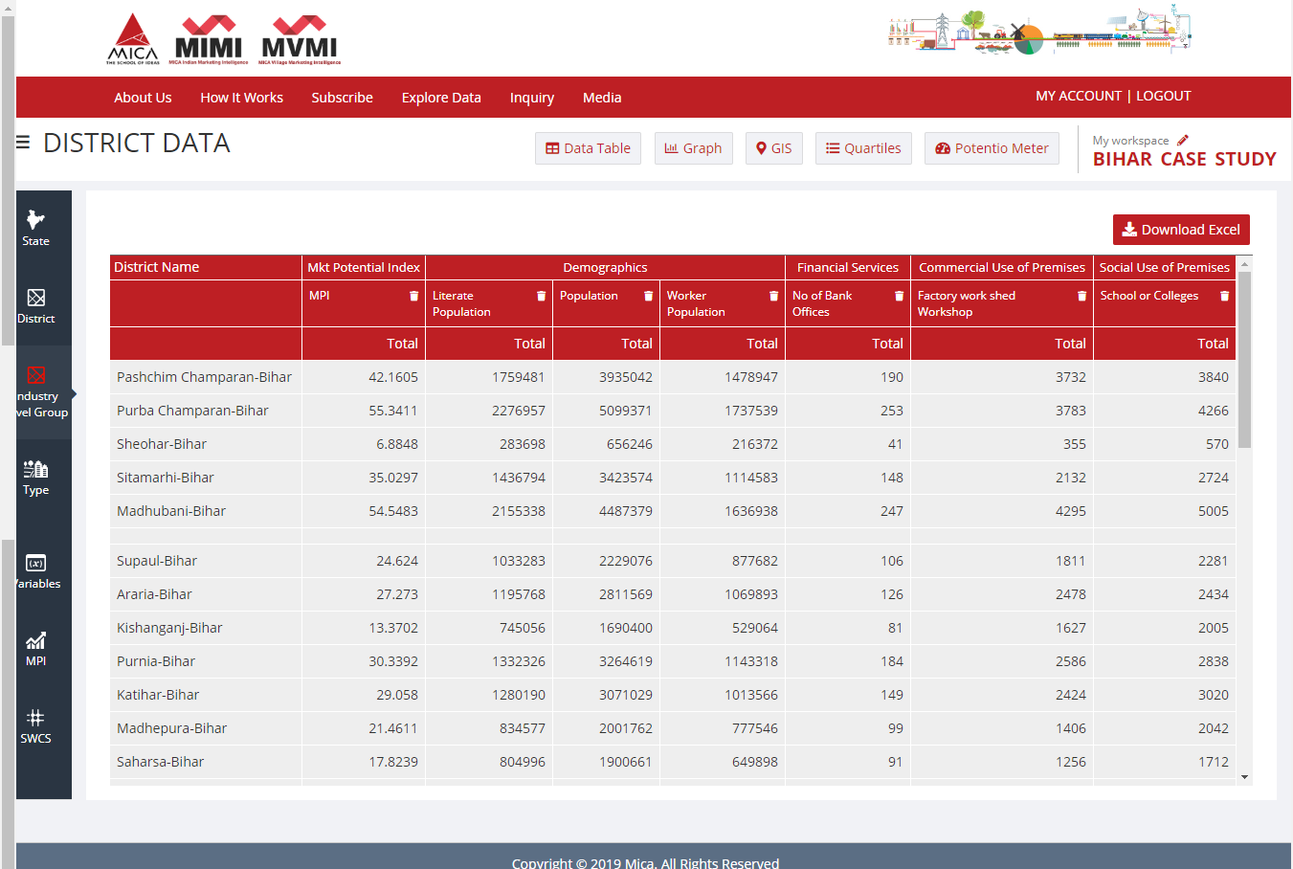
Record your selections: My Workspace

Slide 42
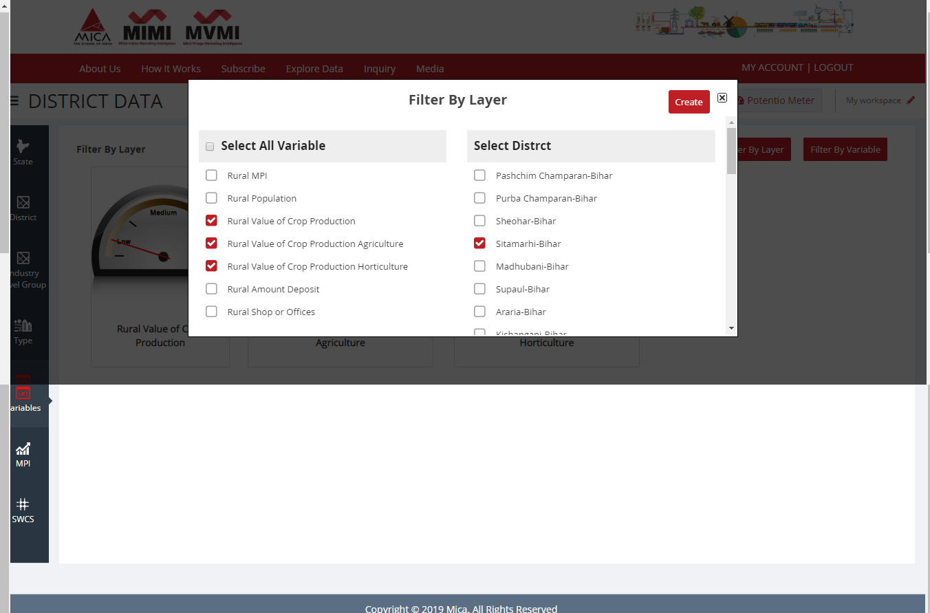
Potentio Meter
Filter by layer : compare variables for a particular district

Slide 43
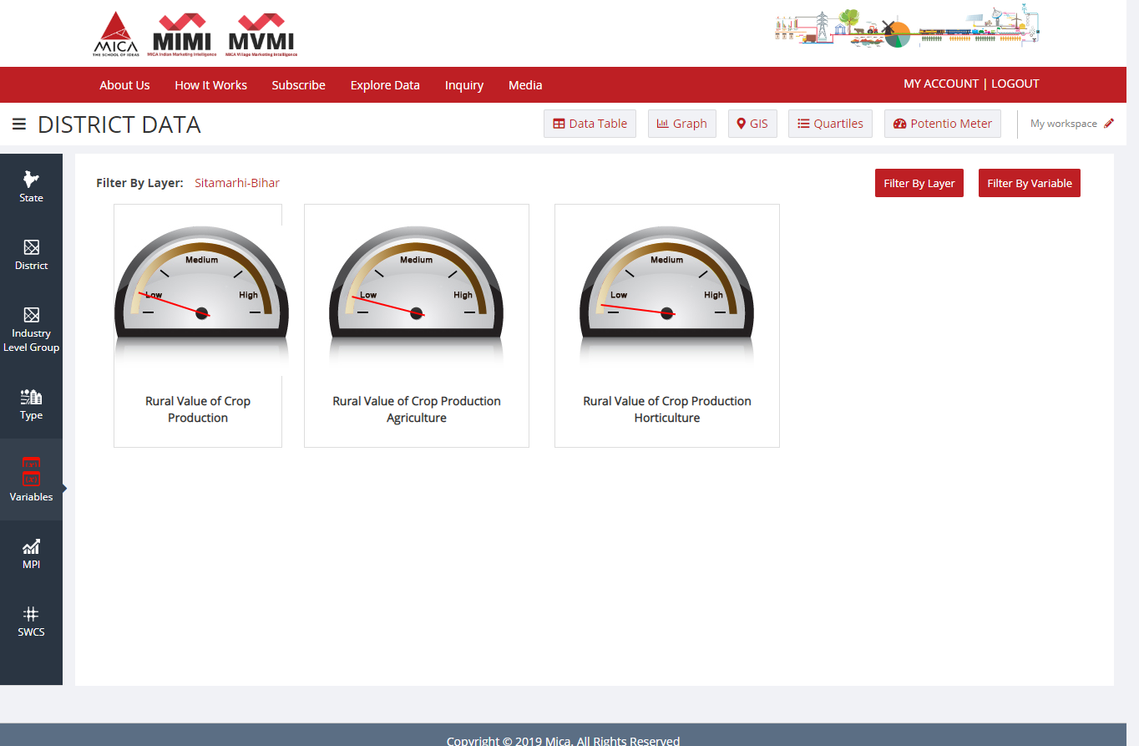
Potentio Meter
Filter by Variable : compare districts with a particular variable

Slide 44
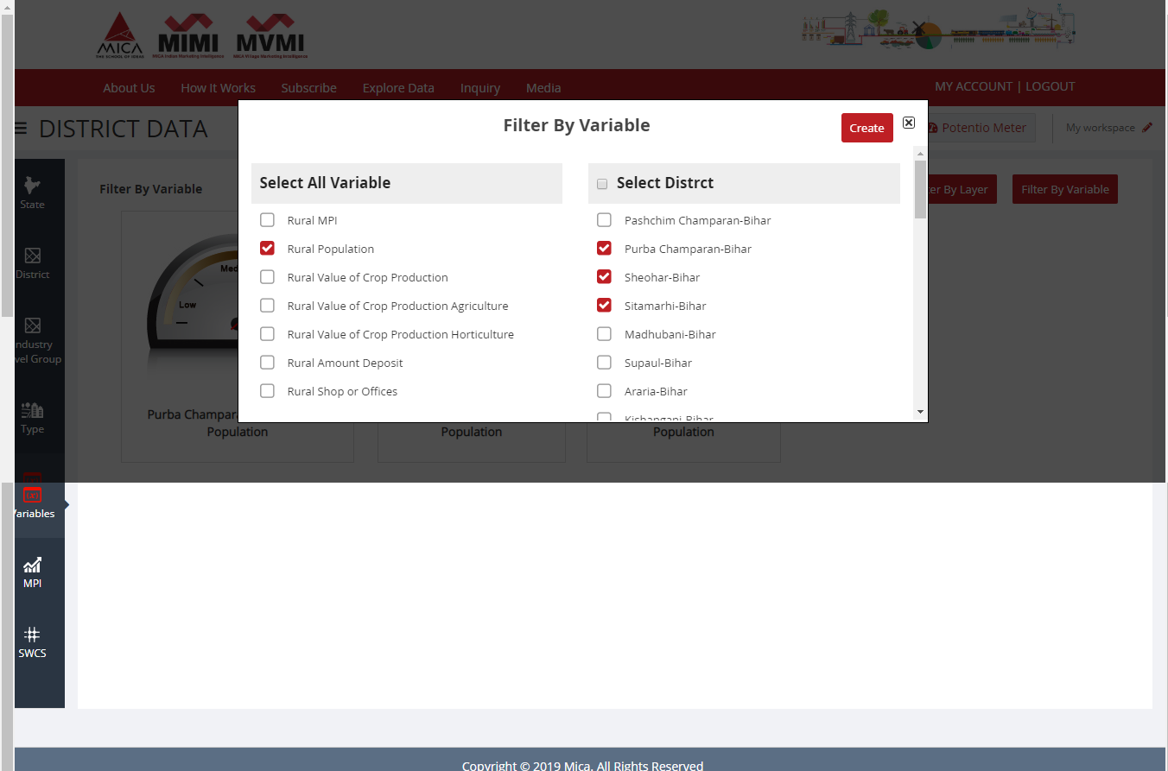
Potentio Meter
Filter by Variable : compare districts with a particular variable

Slide 45
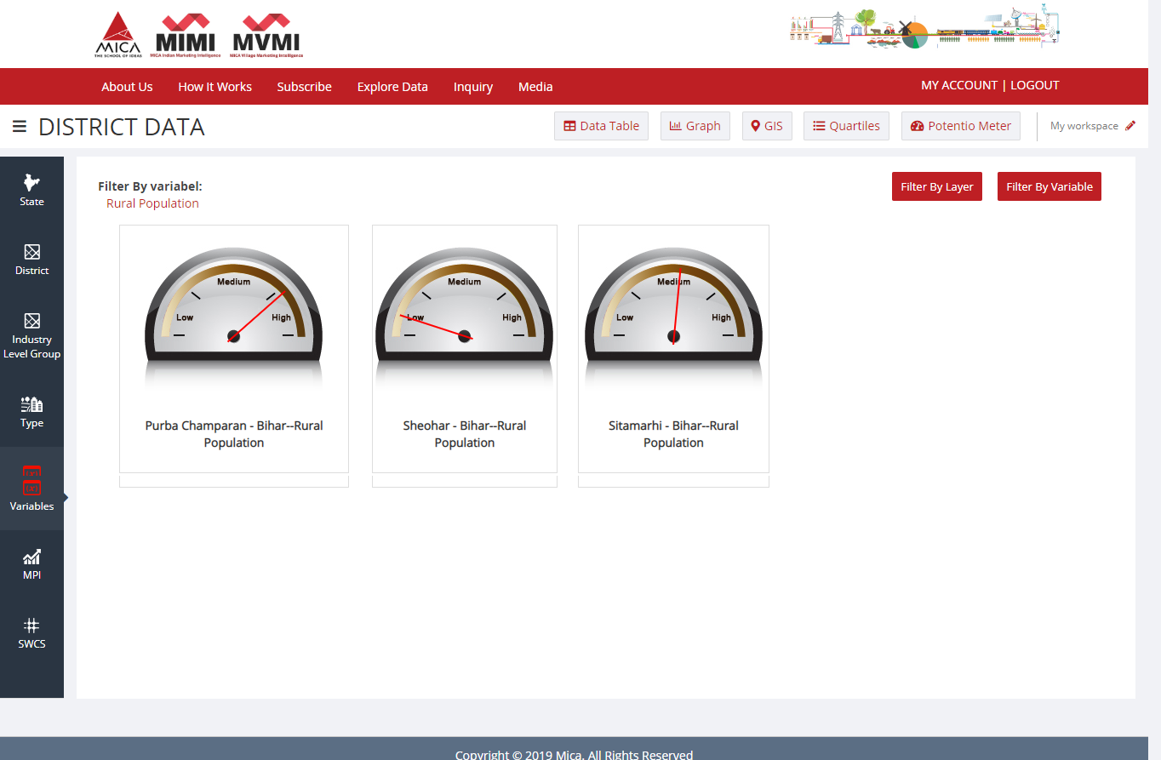
Potentio Meter
Filter by Variable : compare districts with a particular variable

Slide 46
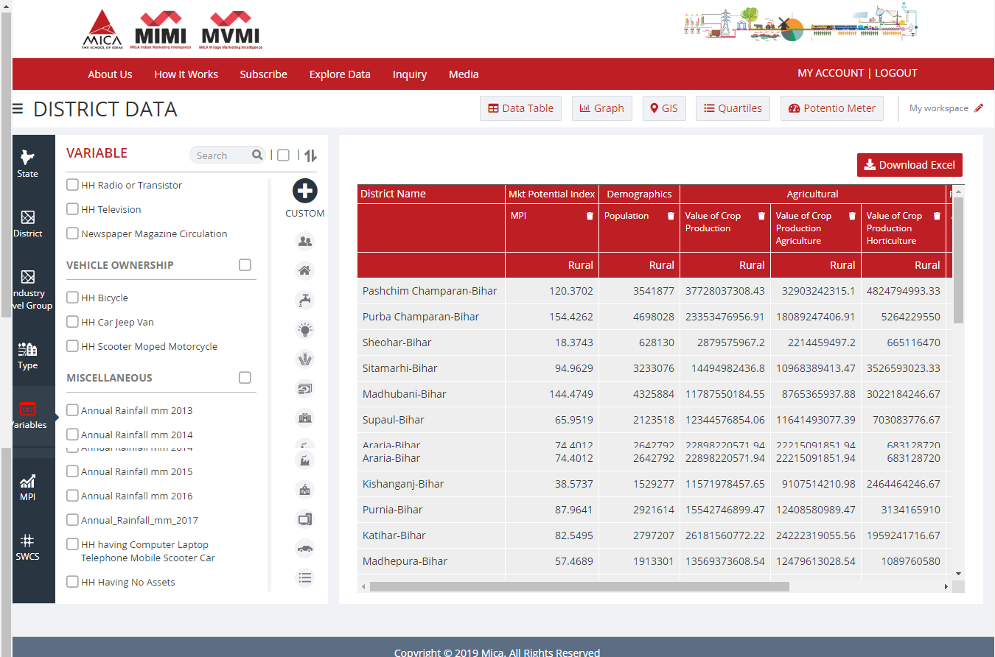
Custom To create new variable using mathematical operators
Please Click ‘+’ to Open ‘Selection Summary’ Menu

Slide 47
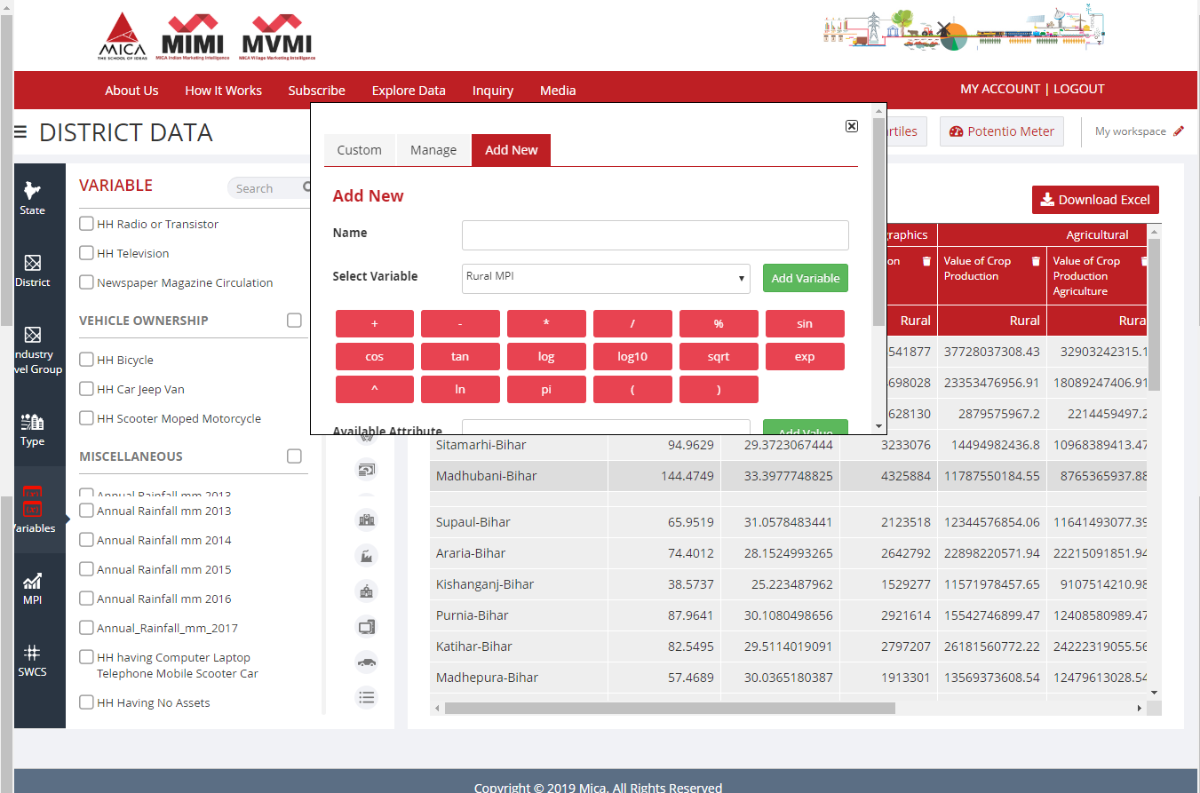
Custom To create new variable using mathematical operators
Name the new variable
Chose MIMI variables and click ‘Add Variable’

Slide 48
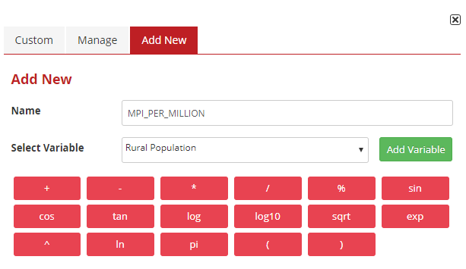
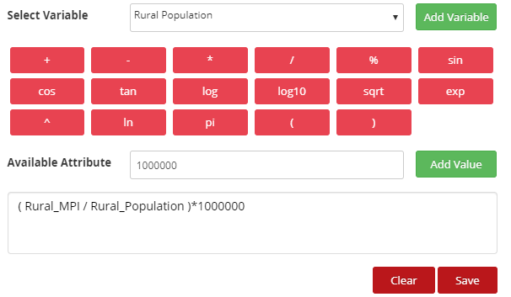
Custom To create new variable using mathematical operators
Save and Continue

Slide 49

Custom To create new variable using mathematical operators
Here, It is

Slide 50
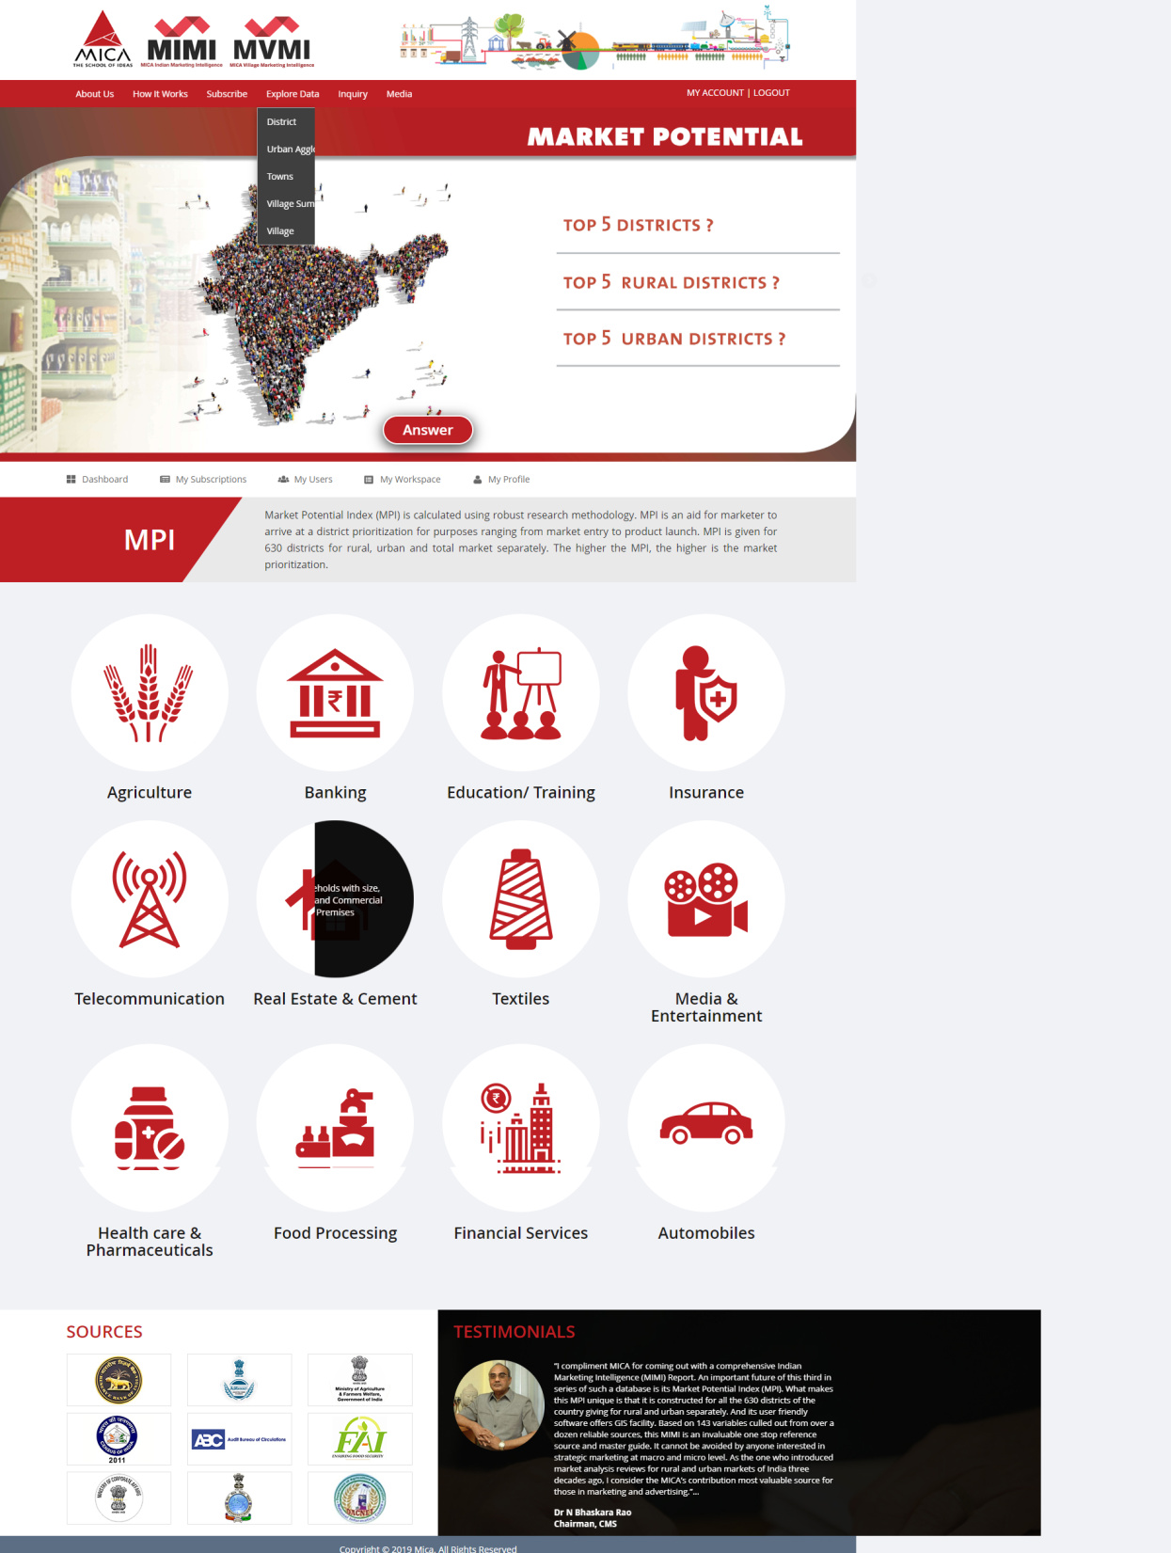
Urban Agglomeration Data
Explore Data Urban Agglomeration Database by clicking here.

Slide 51
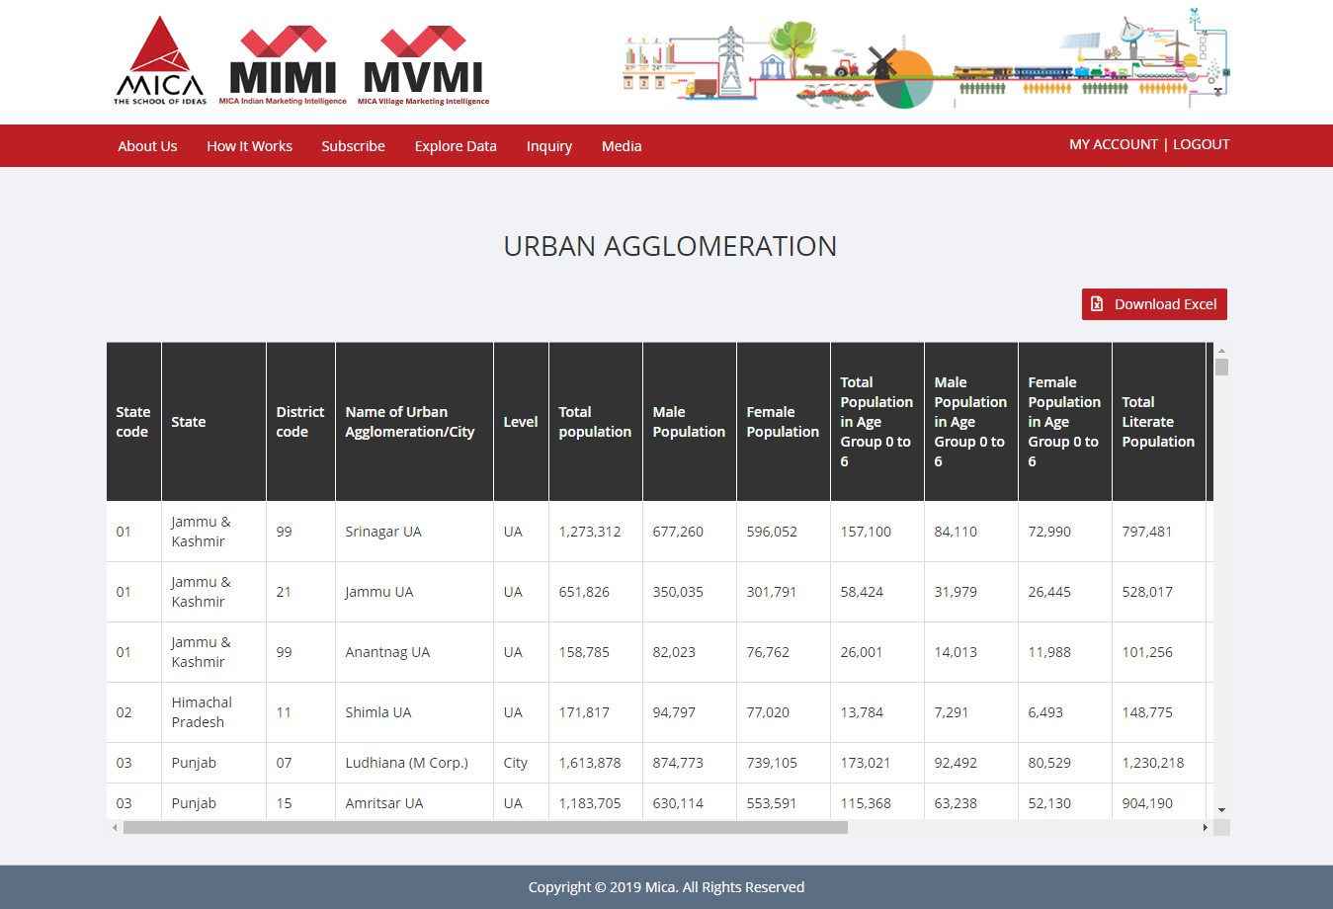
Urban Agglomeration Data
Click here to Export your Selected Database

Slide 52
Towns Data
Explore Data Town level Database by clicking here.

Slide 53

Towns Data
Click here to Download Towns Data
Click here to refer definition

Slide 54

My Account
Click here to get information regarding your Account

Slide 55

My Account Information

Slide 56
Thanks a lot….
Let’s build a solid marketing strategy for India
with MIMI today
Contact us :-MICA, Ahmedabad
Shela, Ahmedabad - 380 058
Gujarat, India
Tel: +91 02717 – 308250.
E-mail: mimi@micamail.in
Web-address: www.mica-mimi.in

